Slide 1
Microsoft Power Virtual Agents in a Day - Preview
Speaker Name

Slide 2
Instructors & Leaders – Please Start Here
Please ensure you have read the Train the Trainer deck for PVA in a Day Preview. This contains how to run in a day and includes updates for the latest preview version of the material.
Please delete or hide this slide once you have completed this.
Notes:
Optional slide to ask participants to introduce themselves.

Slide 3
Agenda
Module | ID | Name | Length
Overview | 1 | What is Conversational AI? Introductory Presentation | 60 minutes
Module 1: Access and Setup | 2 | Access your tenant and preview access | 15 minutes
Module 2: Planning your bot | 3 | Plan your bot using the planning template from the Bot Building Playbook | 40 minutes
Module 3: Creating your bot | 4 | Create your first topic, test and publish your chatbot | 60 minutes
Module 4: Authoring 101 in Unified Canvas | 5 | Author bots using the latest features in Power Virtual Agents | 60 minutes
Module 5: Using Power Automate Connectors in PVA | 6 | Build Power Automate flows for your chatbot | 60 minutes

Slide 4
Power Virtual Agents Train the Trainer Presentation Deck

Slide 5
Introductions (Instructor)
Notes:
Use this slide to introduce yourself and add contact details

Slide 6
Introductions (Participants)
What’s your name?
Which company/group do you represent?
Which city/country do you live in?
What is your role?
What are your expectations from this training?
Notes:
Optional slide to ask participants to introduce themselves.

Slide 7
Power Virtual Agents Preview Notice
This Power Virtual Agents In A Day training is in Preview status and is referencing Power Virtual Agents Unified Authoring release that is in Preview. This is a smaller set of content aimed at familiarizing yourself with core features of Power Virtual Agents using the new features released
Notes:
You may wish to highlight the PVA in a Day is currently under preview

Slide 8
‘Introduction to Conversational AI’
Notes:
Switch to your Introduction to Conversational AI session and once completed, come back here to begin your Lab exercises

Slide 9
Build your first chatbot

Slide 10
PVA Information Architecture
Microsoft Dataverse Environment
PVA BOT (0, 1 or more bots in an environment)
User Topics (1 or more in a bot)
System Topics (8 pre-defined in a bot)
Conversation Tree (1 per topic)
Trigger Phrases
Conversation tree
Trigger Phrases
(read only in system Topics)
Prebuilt Entities
Custom Entities
Prebuilt Entities
Custom Entities
Power Automate Flows
Bot Framework Skills
Power Automate Flows
Bot Framework Skills
Notes:
You can have one or more bots in your Microsoft Dataverse Environment.
It’s common to have 25+ user topics within a chatbot. Within each topic you construct a conversation tree.
A conversation tree consists of trigger phrases, multiple nodes, conditions, the ability to use entities and call actions (flows or skills). Note that to use Power Automate flows in a Power Virtual Agents chatbot they must be in a solution, within the same Dataverse environment as the chatbot
You can redirect/call another user topic or system topic from within a conversation tree.
Power Virtual Agents comes with:
4 pre-defined user topics that you can use or delete. These are useful for learning or getting started
8 pre-defined system topics. Think of these as building blocks for your conversation. They include: Greeting, Goodbye, End of conversation survey etc. Recommend minimal editing only for these topics e.g., greeting message only.

Slide 11
Chatbot Creation Process overview
Test your bot
Test your bot
Publish your bot
Create new conversation
Publish your bot
Revise conversation
Measure your bot performance
Measure your bot performance
Create new topics
Revise topics
Create new bot
Revise bot
Notes:
Creating a bot is an easy step by step process.
First you sign up for Power Virtual Agents and create a new chatbot
Then create new topics with trigger phrases and build a conversational tree
Immediately you are able to test this using a test bot and a demo website that can be shared with other users
Once you are happy with what you’ve built, you can publish this bot to different channels that are made readily available by Power Virtual Agents
Each chatbot also has performance analytics to enable a feedback loop so you can continuously and easily enhance your chatbot to optimize the customer experience.
Revising your bot follows the same process.

Slide 12
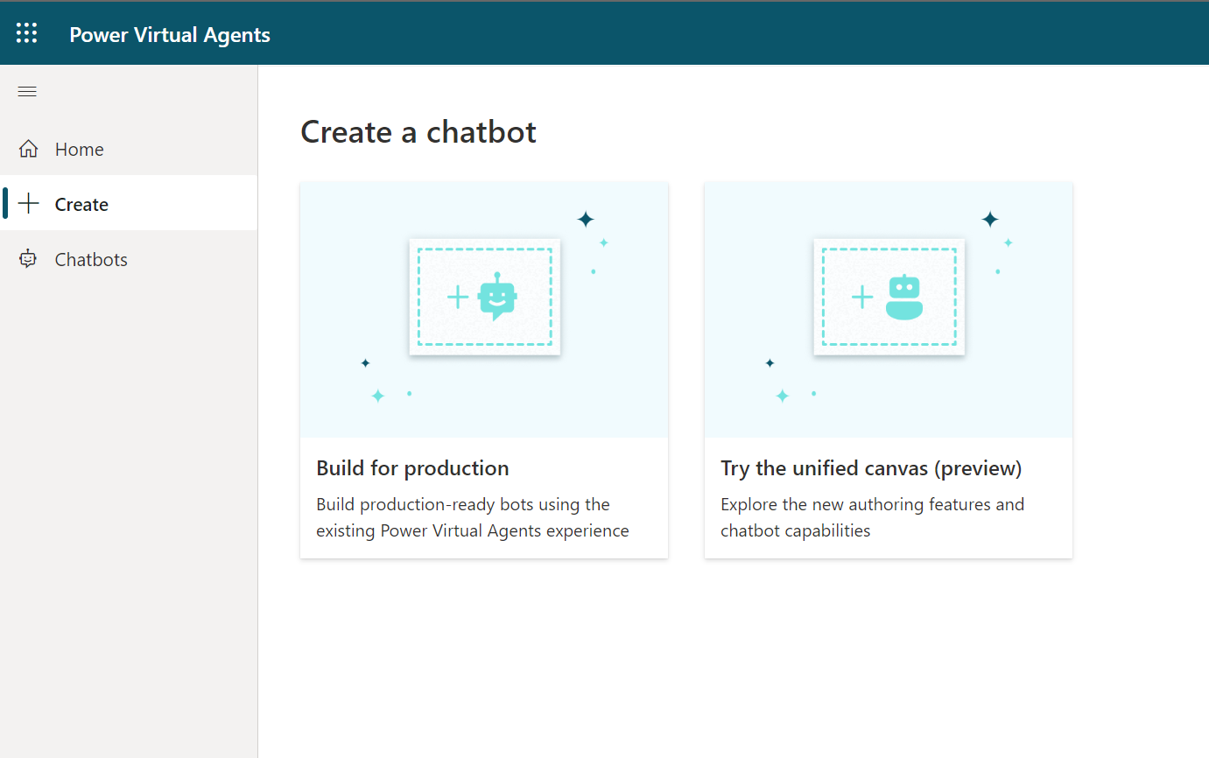
Create a new preview chatbot
Open the Power Virtual Agents designer
Power Virtual Agents
Select ‘create bot’
Notes:
Power Virtual Agents makes creating a chatbot very easy to do.
Open the Power Virtual Agents designer and click on the ‘bot’ icon and then select ‘new bot’.
Choose a name for your new chatbot.
Select your language
Select your Environment.

Slide 13
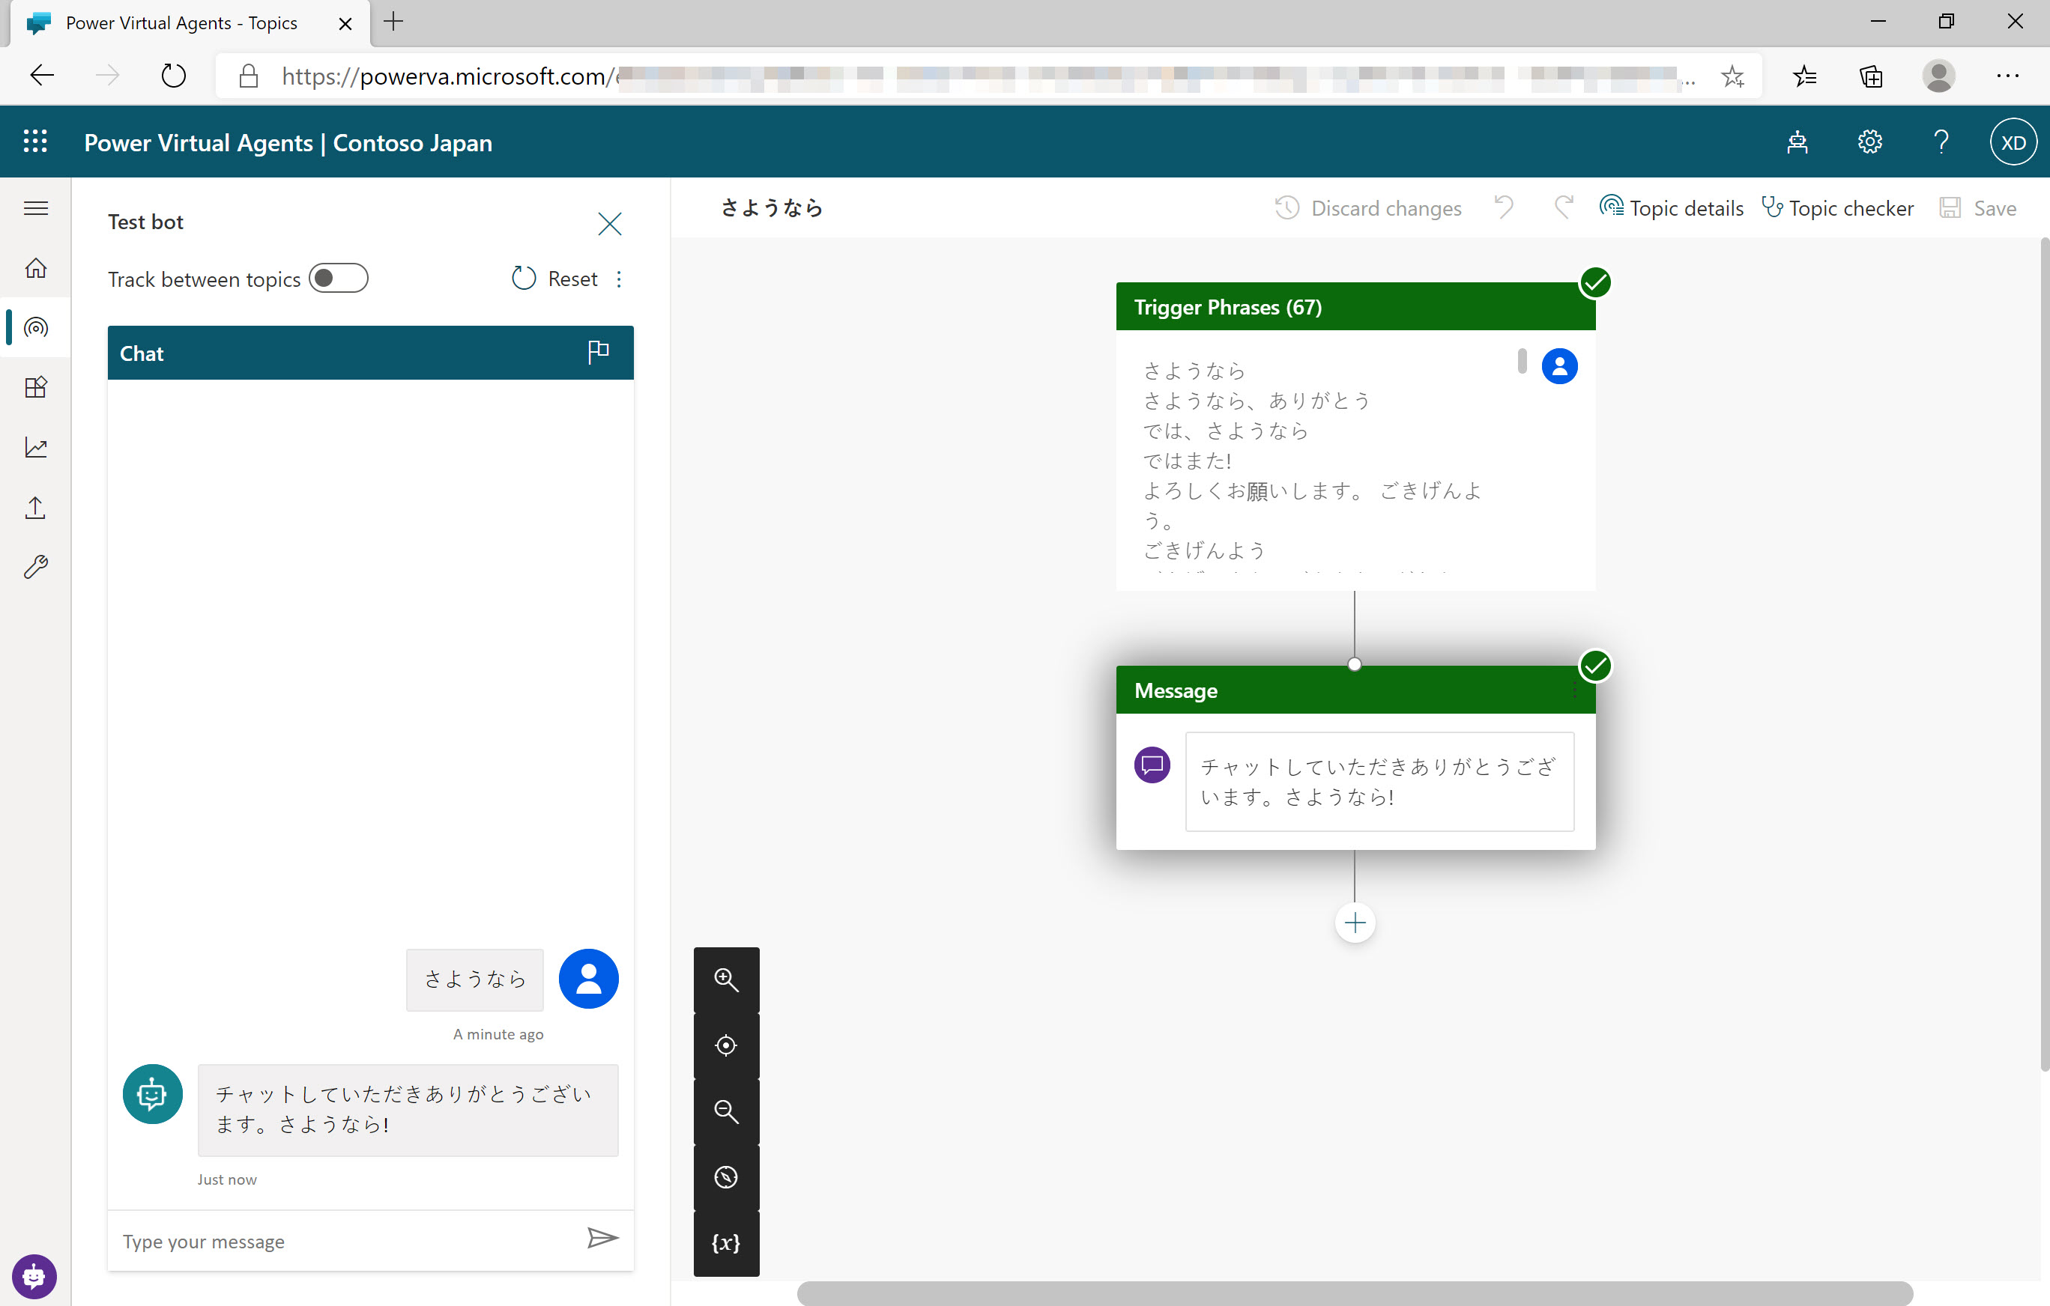
Supported Languages
PVA supports chatbots in many different languages
PVA Unified Authoring Preview is currently available only in English when creating your bot
There will be more supported languages throughout Preview
Notes:
You can create chatbots in Power Virtual Agents in a number of languages.
Each bot speaks one language, it’s not a multilingual single bot
You specify the target language when you first create a bot
For a full list of languages supported, see: https://docs.microsoft.com/en-us/power-virtual-agents/authoring-language-support

Slide 14
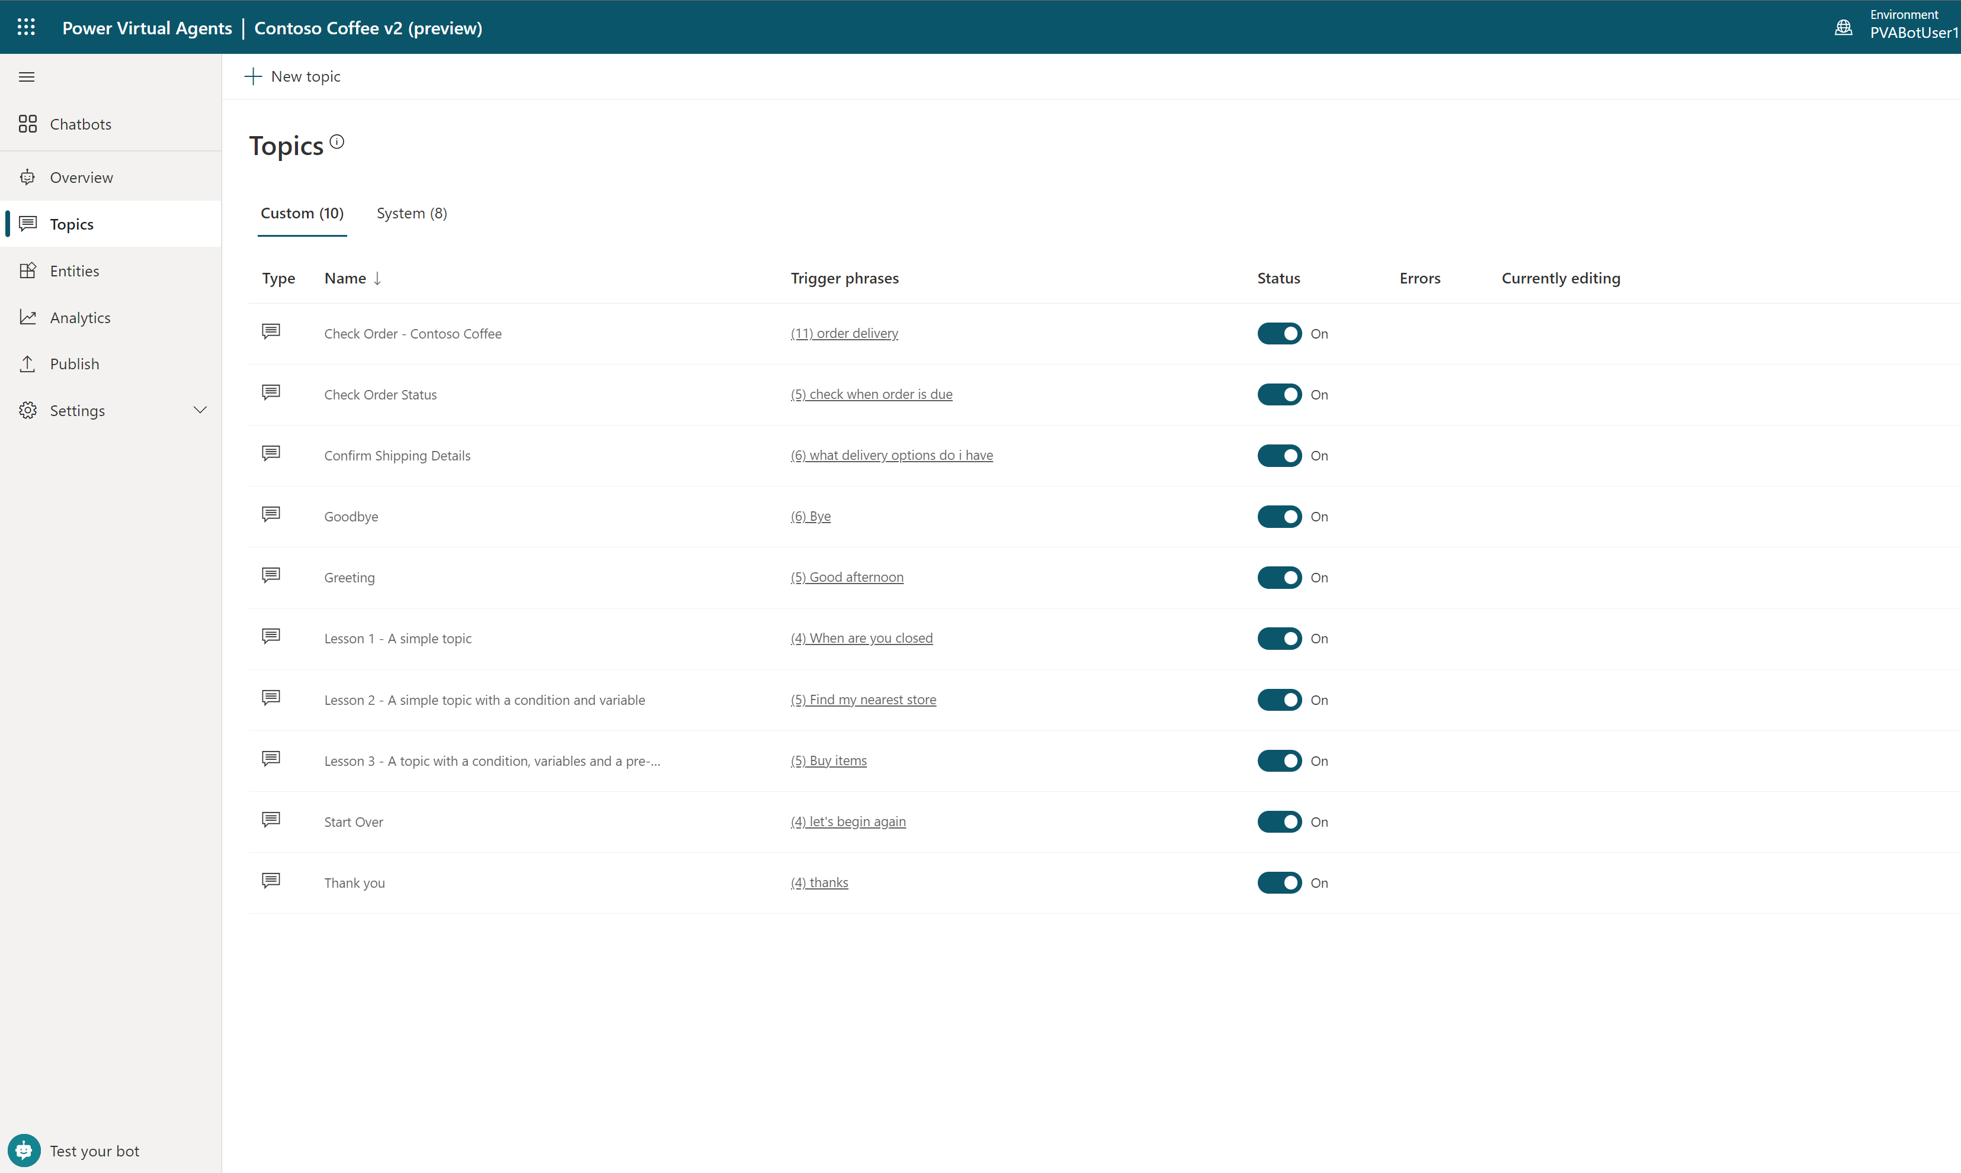
View topics
A chatbot comes with 4 User topics & 8 system topics
Using one of the 4 topics to get familiar with the structure
Notes:
When you create your chatbot, you need to decide what business scenarios you want your chatbot to address. You’ll create a topic for each scenario/question you want the bot to address.

Slide 15
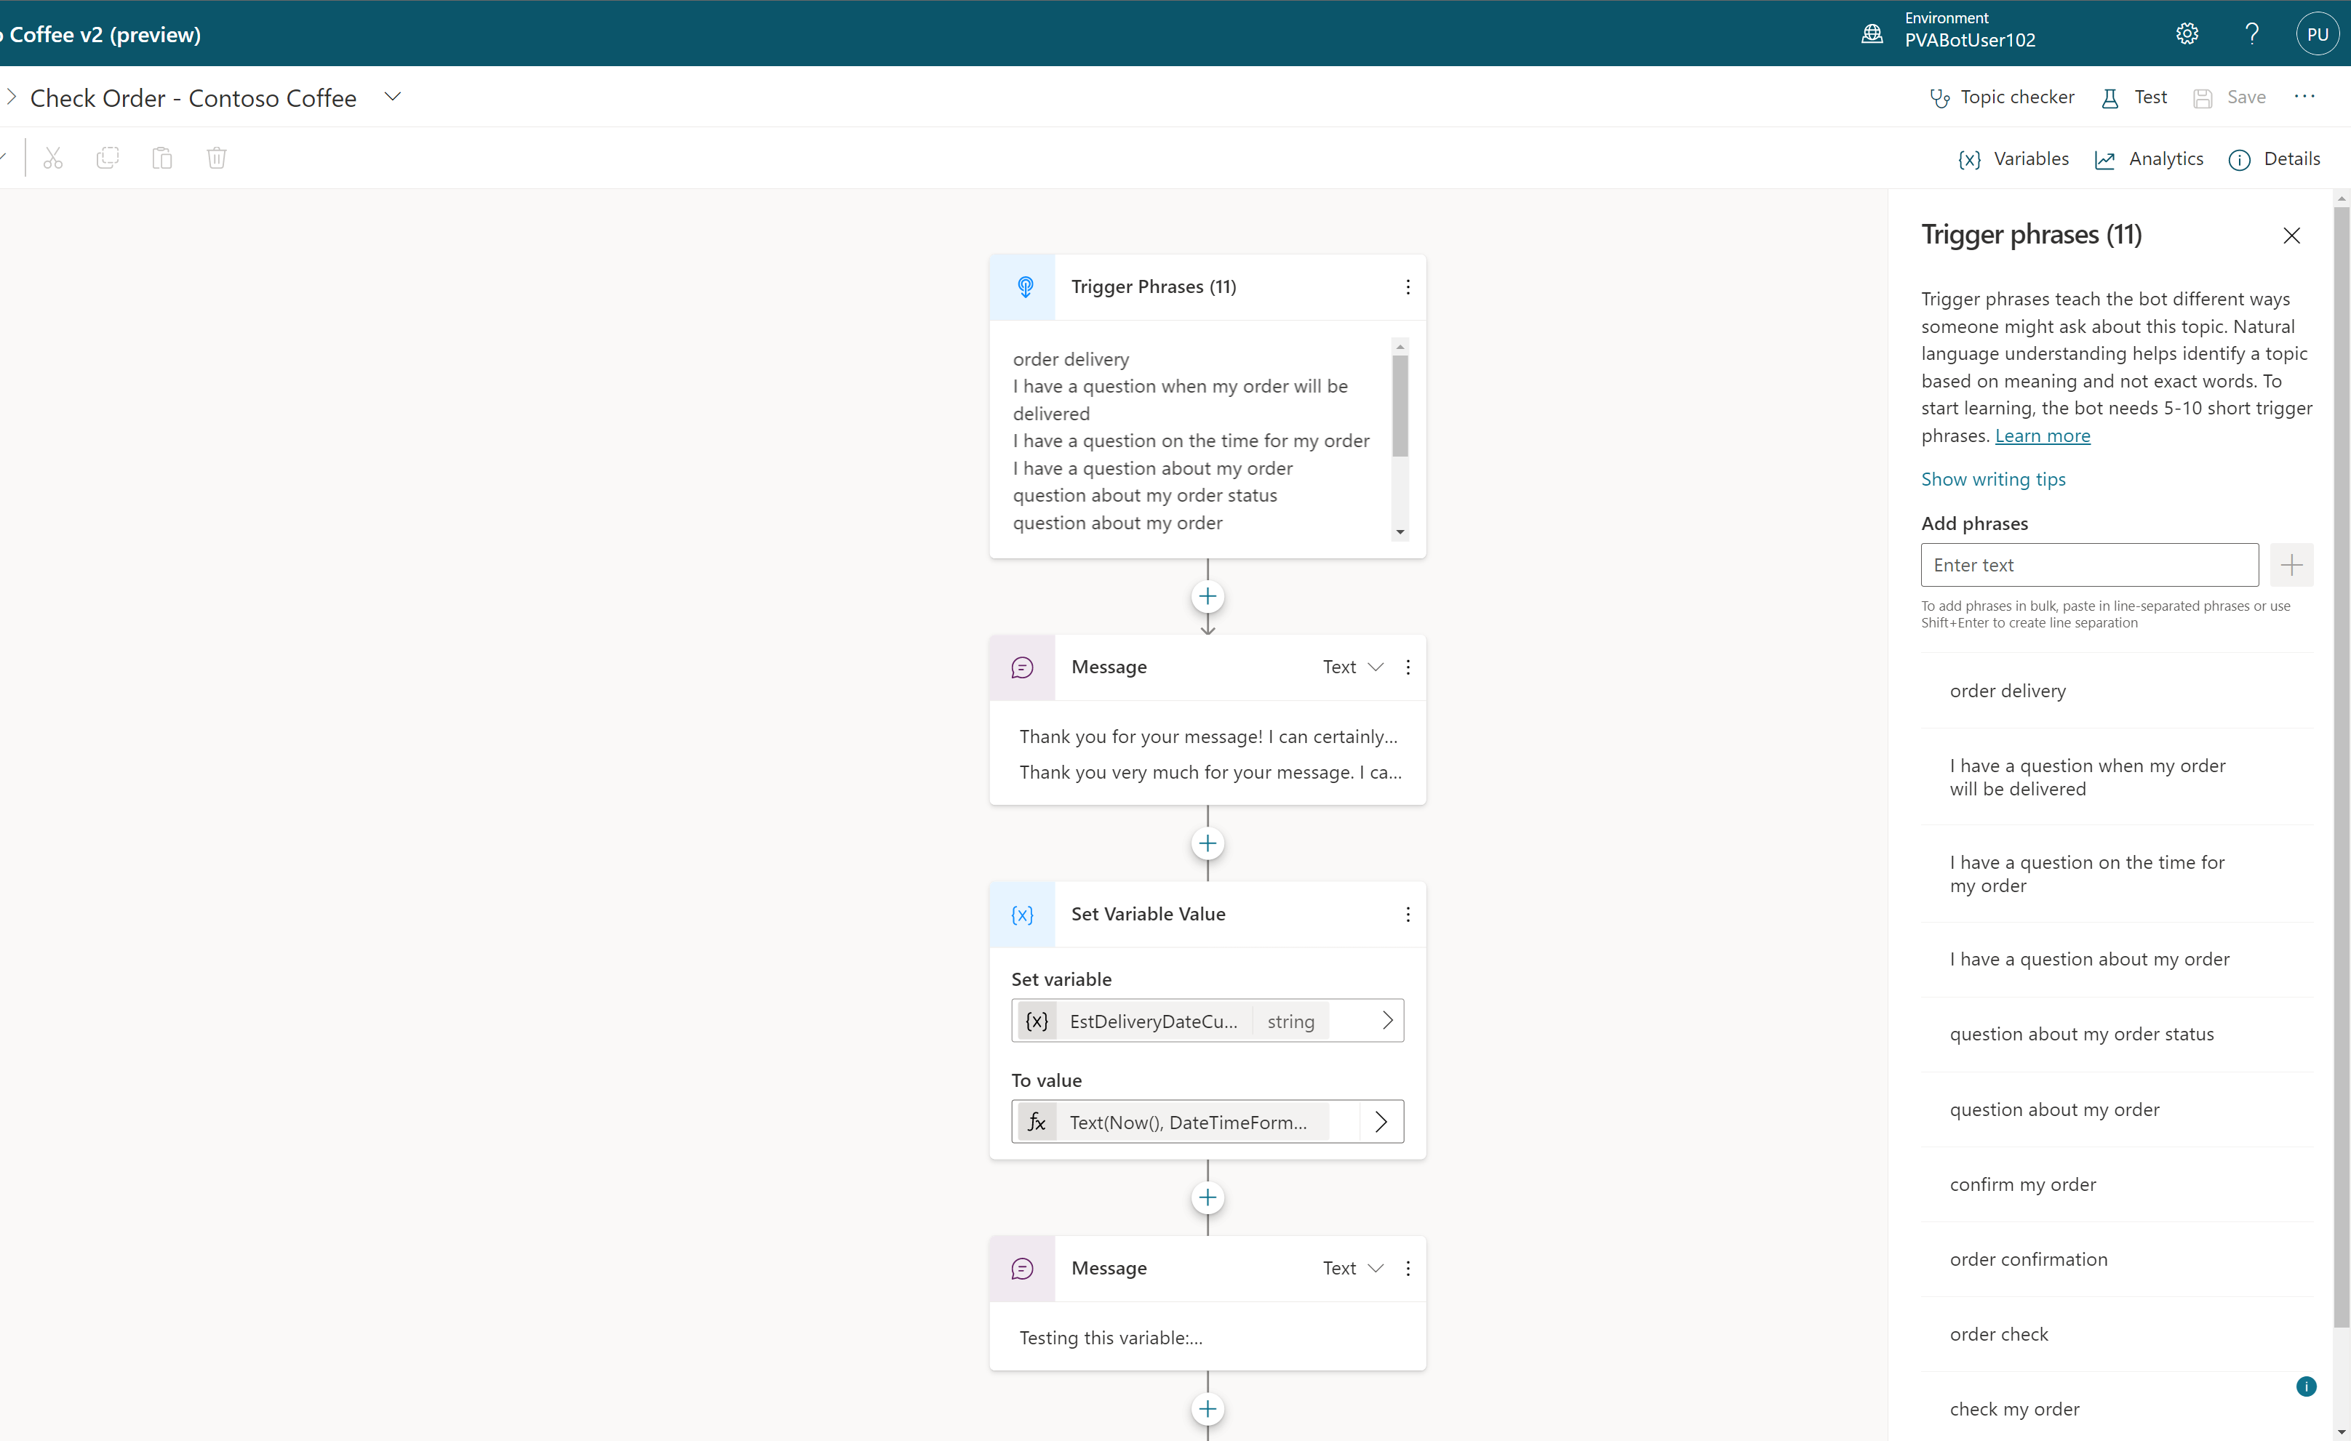
Add conversational trigger phrases
For a topic you’ll define a few trigger phrases
A trigger phrase is a way to describe an intent, it captures the way a customer might ask about a problem/issue. E.g., “problem with weeds in lawn”
You only need to provide at least 5 phrases – the AI will parse whatever the user says and trigger the topic closest in meaning to the user utterance
Notes:
Your chatbot must have the appropriate trigger phrases relevant to your topic.
A topic has trigger phrases—these are phrases, keywords, or questions that a user is likely to type that is related to a specific.
The AI uses natural language understanding to parse what a customer actually types and find the most appropriate trigger phrase or node.
You should start with 5-10 trigger phrases for each topic. Your phrases should be semantically different. They don’t need to be full sentences.

Slide 16
Open the authoring canvas and begin editing a topic
Open authoring canvas to view the conversation tree
You’ll see the trigger phrases at the top. You can edit the conversation tree, adding questions the bot should ask, things the bot should say etc.
Notes:
Open the authoring canvas and begin creating your chatbot. The easy to use and understand dialog tree enables any user to start creating a powerful chatbot experience.

Slide 17
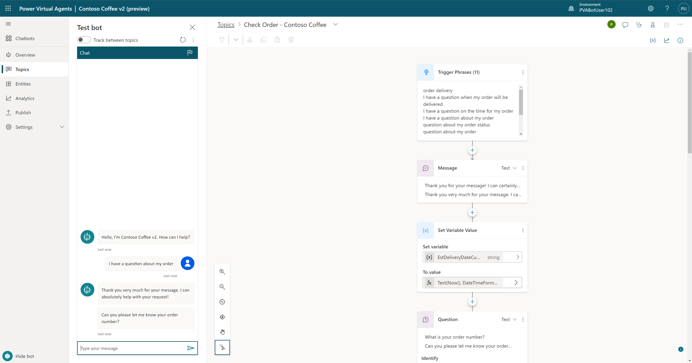
Test your topic as you construct it
To test what you’ve created click on test bot (bottom left) to expand test window
Turn on “Track between topics”. This lets you trace your way through both this topic and any others you call

Slide 18
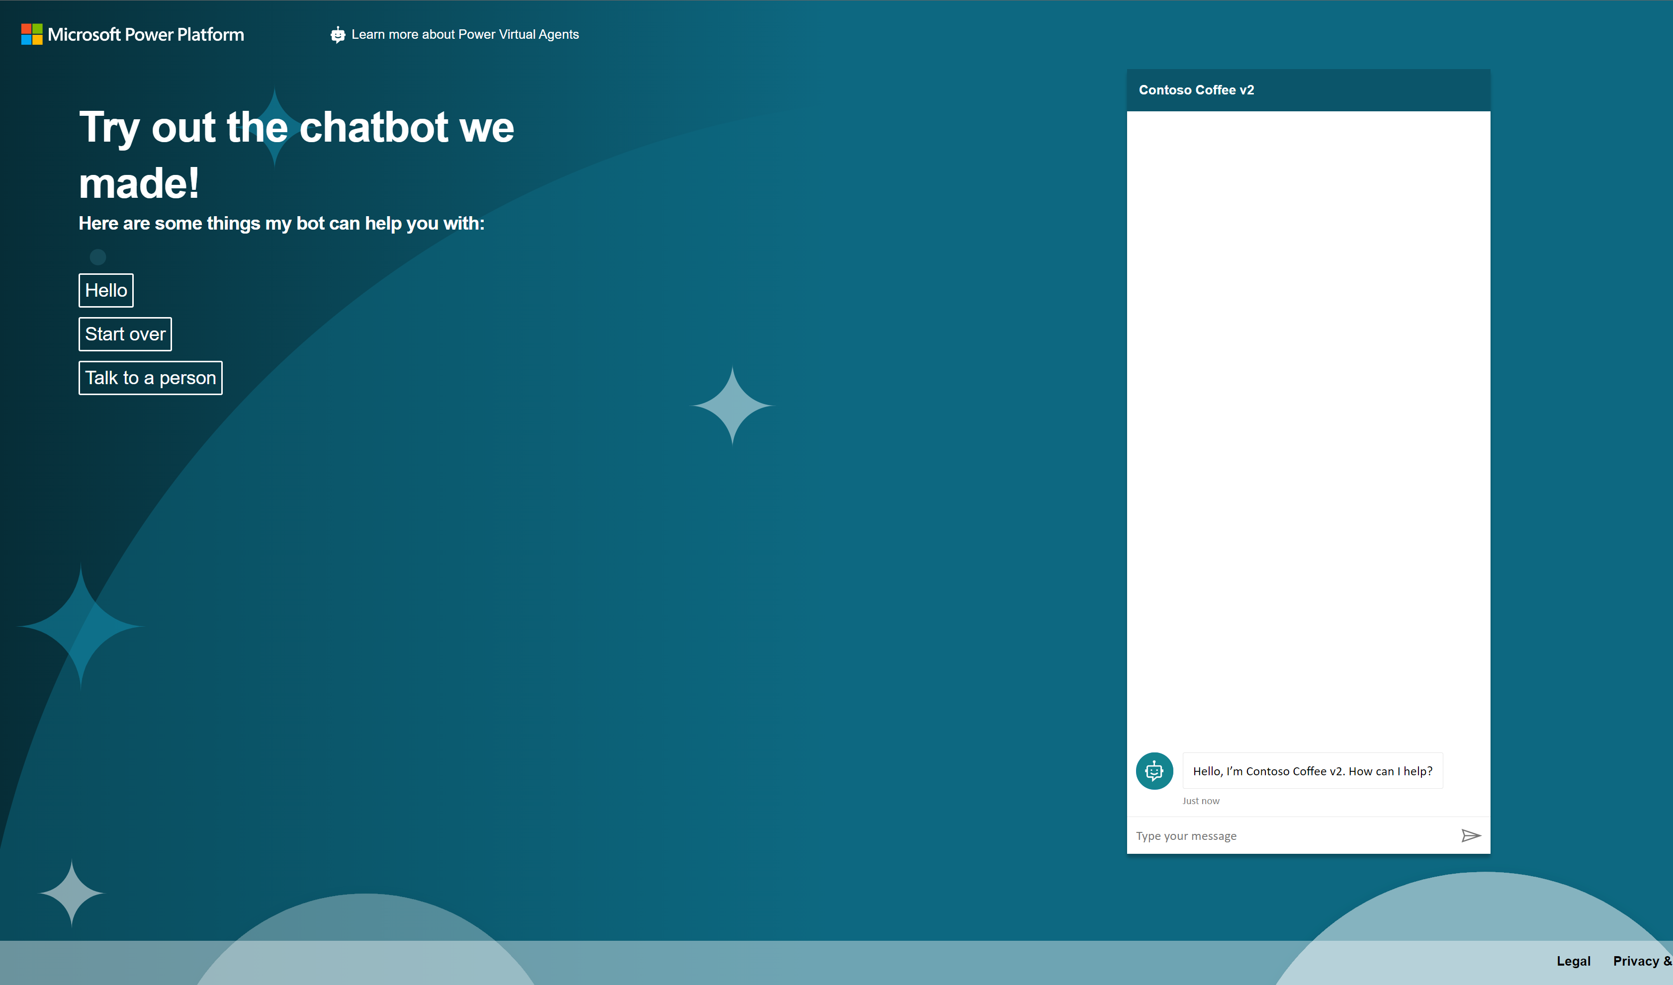
Publish to demo website
Publish to demo website and share the URL with colleagues so they can try the bot
Add screen shot with that publish to demo site show and demo page

Slide 19
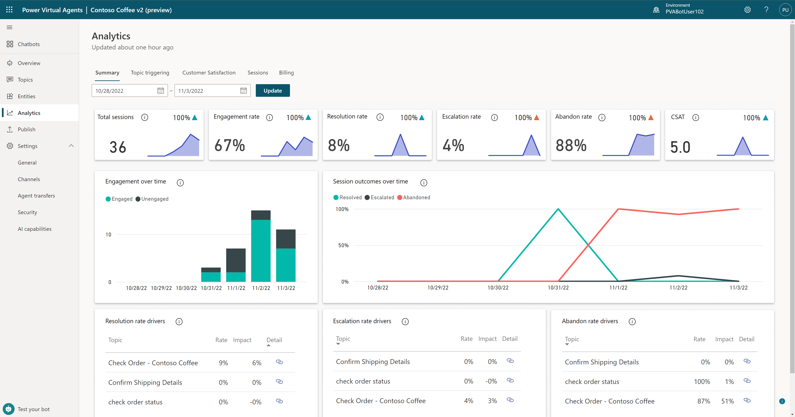
Enhance your chatbot from Analytics
GAIN VISIBILITY OF MANY PARAMETERS
Summary charts
Engagement over time chart
Session outcomes over time chart
Resolution rate drivers chart
Escalation rate drivers chart
Abandon rate drivers chart
Notes:
Easily see what’s working and what to improve
Analyze bot/customer conversations to better understand how specific topics are performing, what’s impacting your CSAT, and identify where there is room for improvement
Quickly figure out what to build next
Easily see which conversations are going to human agents and determine which topics to teach your bot next

Slide 20
Introduction to NLU
Natural Language Understanding (NLU) is a subfield in Natural Language Processing (NLP).
It focuses on organizing the user’s unstructured inputs (utterences) so that the bot can understand and analyze it.

Slide 21
Example in action: topic triggering and slot filling
Utterance
“What’s the weather in Orlando?”
Topic: Check Weather
Entity: Location = Orlando

Slide 22
SECTION SUMMARY
Power Virtual Agents enables users to create a chatbot in just minutes
Offers an easy to use designer to help create unique customer chatbot experiences
Part of the Microsoft Power Platform
Built on Microsoft Dataverse

Slide 23
Lab Introduction

Slide 24
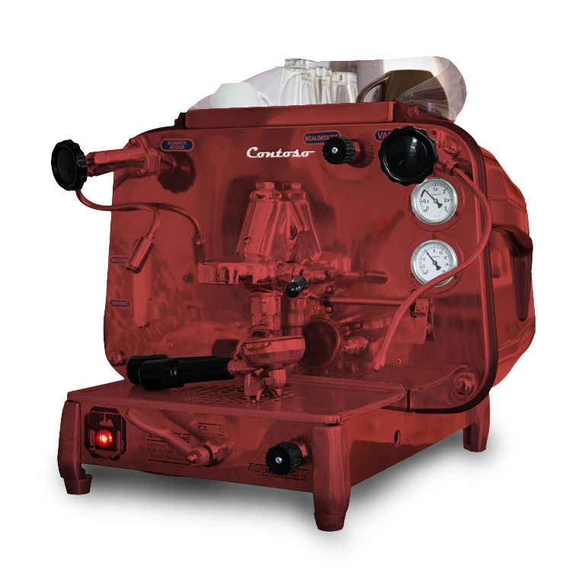
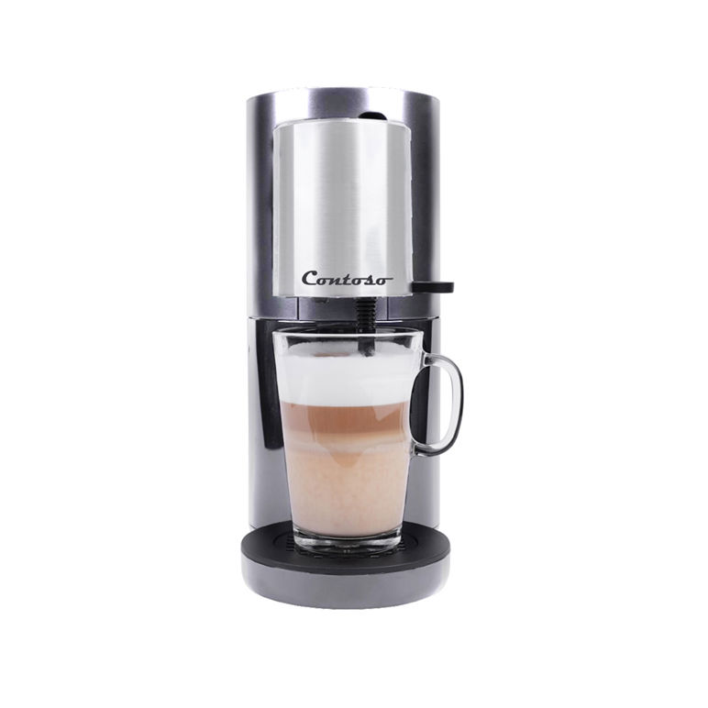
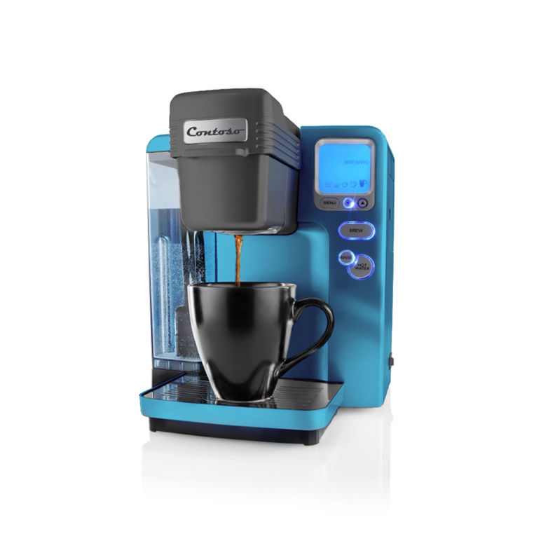
Introducing Contoso Coffee
Welcome to Contoso Coffee! At Contoso Coffee, we are passionate about providing efficient, environmentally sustainable, and innovative coffee products, barista experiences, and services.
Customer support costs have continued to rise as the customer base has grown, and the company can no longer continue to expand the Customer Support team. You have been tasked with finding a solution using Power Virtual Agents.
Notes:
Do note that in the preview material, there is one lab which does not include this use case – that is the Power Automate Lab
Also customers can also use their own company or examples if you want to

Slide 25
Lab Material
Download and unzip the package:
https://aka.ms/pvapreviewlabs
Download the Bot Building Handbook:
https://aka.ms/PVAPlaybook
Notes:
https://aka.ms/PVAinaDayPackage

Slide 26
Lab 00:
Getting Setup and Access

Slide 27

Setup your Public Preview Instance and logging in – Lab 00
You should be able to login to your environment using the instructor provided logins
You will have a Power Virtual Agents trial license assigned to you
To test you have access to the latest Power Virtual Agents Preview functionality, navigate to web.powerva.microsoft.com and you should see the following features when you first log in (displayed on the next slide; you may need to create a GA bot first)

Slide 28
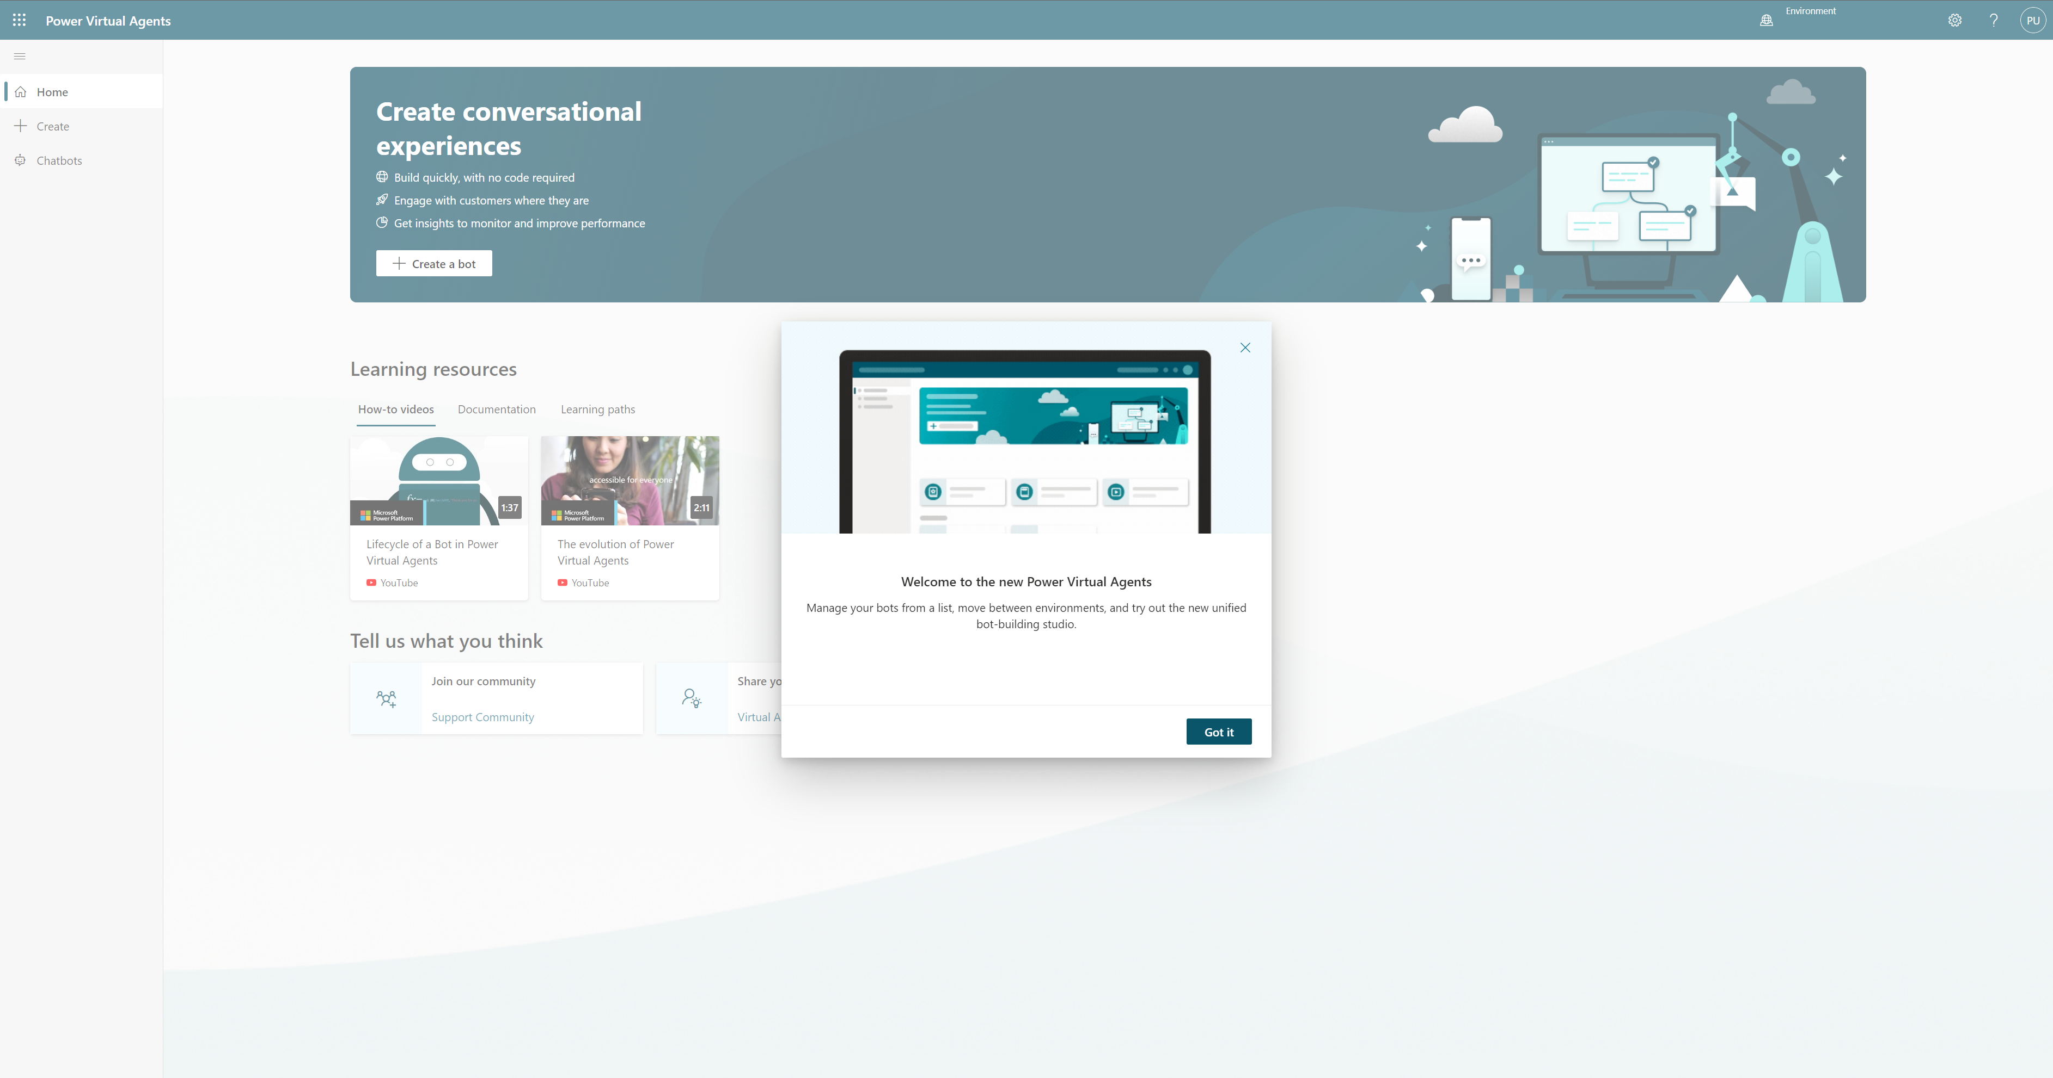
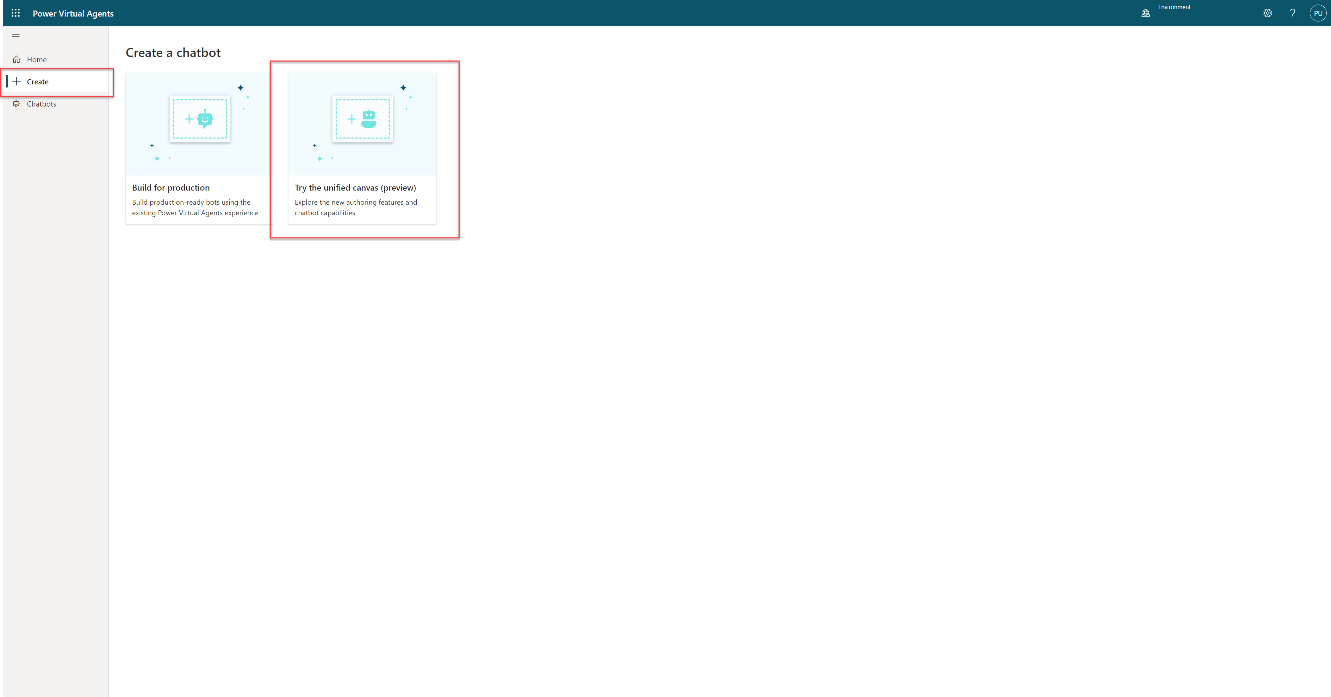
A welcome dialog highlighting the latest version of Power Virtual Agents
Click ‘Create’ and you should see a window as shown above with two selections. You need to select ‘Try the Unified Canvas (preview)

Slide 29
Lab 01:
Conversational Design and Planning your first Bot

Slide 30
Planning your first bot - Ideation
Planning your bot is essential for the success of your project
Setting goals when implementing any business system should be driven from business value
Take your time planning and do not rush

Slide 31
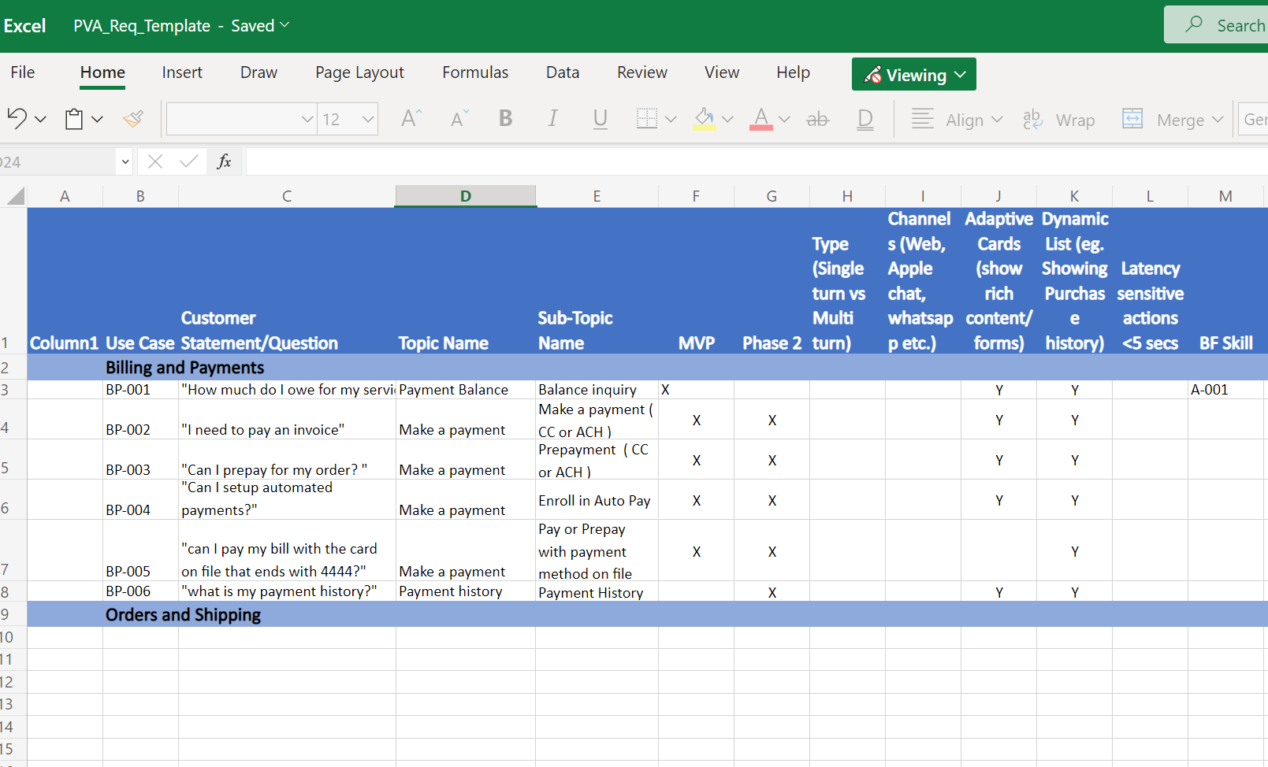
Planning your first bot – Requirements Gathering
Topic Planning is essential to be able to map the range of topics you want to enable for your users
Use the template provided in the Bot Building Handbook to log key information about the topics
Additional information can be added and developed as you go

Slide 32

What makes a chatbot successful?
Knowing your customer
Having accurate, latest and effective content
Knowing when to hand off to a human
Understanding the customer’s request and connecting it to the right topic
Providing personalized, context-aware help, and taking actions for the customer

Slide 33
Types of conversation topics
People use your bot with a specific issue (“topic”) to address or resolve. You can loosely categorize topics into 3 types:
Informational
What is…? When will…? Why…?
Task completion
I want to… How do I…?
Troubleshooting
Something isn’t working right. I got an error message
Notes:
Informational, Task Completion, and Troubleshooting are different types of topics that the chatbot can support. You may also need some topics that are just there to take ambiguous user questions (“I need help” or “shopping”) and ask for clarification so you can then route the user to the correct topic.
When you are considering which business processes to automate, look for the ones with the highest traffic and those where the task can be completed in the chatbot without the need for human involvement. Don’t just replicate what your website can already do – most customers are familiar with websites and will accomplish these tasks themselves without needing to interact with a chatbot. Look to create topics for things which generate a high volume of calls. Build automations for those to start with, and then work on the longer tail of other topics over a period of time.

Slide 34


Designing a topic
Identify the topic
List all scenarios
Design a high-level conversation tree
Design solutions
Validate and iterate on the design
Choose a topic your bot audience will ask about
Focus on high-impact topics first
Put your customer empathy hat on … topic design requires understanding both sides of the conversation
List all possible scenarios
Think about informational needs, task completion, and troubleshooting
Use your favorite tool to draw the conversation tree
What is the fewest number of questions you can ask to understand the situation enough to provide the right solution?
Integrate with Power Automate to personalize and speed issue identification
Make answers clear and concise so users can scan information quickly
Integrate with Power Automate to take action on the user’s behalf
Read the dialog out loud before publishing
Get analytics and read session transcripts for further optimization

Slide 35
Chatbot conversation styles

Slide 36

Qualities of a good conversation
Cooperative
Goal-oriented
Fast
Turn-based
Truthful
Polite
Source: Erika Hall, Conversational Design
Notes:
Good quality conversation styles you need to adopt:
Cooperative: without cooperation between the chatbot and the customer there is no conversation. Conversation flow should be built in a manner that the customer does not need to put in any effort or have any special knowledge or understanding of your design
Goal-oriented: basic principle of conversation design. Every step or turn needs to have a goal in mind. Why is it being asked or shown to the user?
Fast: successful conversations move at a fast past.
Turn-based: It is also critical to provide the right information at the right time and verify that it’s correct before moving forward. Poor interaction requires the participant to backtrack and make corrections, which slows everything down and adds effort to the process
Truthful: Humans have strategies to prevent and resolve misunderstanding quickly in context. Similarly, chatbots should validate information before using it to take action.
Polite: there is nothing as polite as respecting the time of someone who has given you their attention. Politeness can also be achieved by making customers investment of time more productive than expected, for example, by anticipating additional needs before they’ve thought to ask by offering additional choices or fewer choices in a polite manner, depending on the context.

Slide 37
Style: How to sound conversational 1/9
Customer conversations should emulate the best elements of any conversation — personal and polite, friendly and supportive
A few stylistic changes in writing can impart warmth and familiarity to your brand voice
Don’t overuse exclamation points to convey energy. It’s easy to rely on them for this purpose, but too many, in the wrong places, could be interpreted as insincere and robotic
Hey Bryan! Would you like the usual — a large cheese pizza?
So you know, there is a buy-a-large-get-a-small-free deal going on through Saturday. Do you want to try this deal?
Yeah!!
Great! Let me get your order started for you.

Slide 38
Style: How to sound conversational 2/9
Use short sentences
Be positive
Use active voice
Sounds great! Let me get that started for you.
Let’s get started. I have a couple questions. Should only take a minute.
No problem. I can resolve this for you.

Slide 39
Style: How to sound conversational 3/9
I’m going to ask you a couple questions. It should only take a minute.
Good choice. I have a couple suggestions based on what you’ve selected.
Great.
Use contractions: “I’m” instead of “I am.”
Select a pronoun to represent your brand agent in chat and be consistent: “I” or “we.”

Slide 40
Style: How to sound conversational 4/9
Be consistent with tone and style so the conversation sounds like it’s with the same agent and brand
Do
Don’t
Hi there. Welcome to the Store Assistant. I can help you make a return or exchange.
Hi there. Welcome to the Store Assistant. I can help you make a return or exchange.
Let me know at any time if you’d like to chat with a live customer service agent.
If you wish to be in contact with a live customer service agent in regards to your problem, please click the button below.
I want to return an item
Tone shifts to formal
I want to return an item
OK. Could you provide your order number, please?
OK. Provide your order number.
Demanding tone

Slide 41
Style: How to sound conversational 5/9
If you’re using website documentation to answer a question, break sections down into short, scannable graphs
Do
Don’t
How to reset your password: 1. Go to https://account.live.com/password/reset. 2. Select the reason for resetting your password and the alternate contact info where you can receive a security code to verify your identity. Note: This alternate contact info is part of the security info you already added to your Microsoft account.
How to reset your Password If you cannot remember your password, go to https://acount.live.com/password/reset and select the reason for resetting your password. Then include the alternate contact info where you can receive a security code to verify your identity. Note: This alternate contact info is part of the security info you already added to your Microsoft account.

Slide 42
Style: How to sound conversational 6/9
Pace the conversation in short, scannable units
Break up messages into separate, readable blocks to make the pace of the conversation feel more natural
Make sure the chatbot doesn’t respond so quickly that it rushes the customer. Add a minimum delay if necessary
Check in to make sure the user is following the conversation after explaining or answering a question, particularly a complex one
Before we begin, what type of account do you have?
Student
OK, what type of device are you using?
Tablet
Great! First, we need to reset your credentials. I’ll walk you through how to do this.
Open Spotlight by selecting the magnifying glass at the top right of your setting.
Then search for and open CountrySetting.

Slide 43
Style: How to sound conversational 7/9
Maintain a friendly tone when helping to complete the task
Tailor the tone of the chatbot’s responses to the context. If it’s something serious—like billing or cybersecurity—be empathetic but brief and straightforward. If it’s a more mundane situation (like creating a new account), the tone can be more relaxed.
Exclamation points don’t express energy or excitement. Strong writing does, particularly strong verbs. In your desire to help, avoid sounding condescending or insincerely enthusiastic.
Don’t
Hi, I need help with my bill.
Oh! The first step is understanding how your service is billed.
Bills can be complex!
Do
I understand you need help with your bill. Can you tell me in a few words what the issue is?
Charges
Account Settings
Payment

Slide 44
Style: How to sound conversational 8/9
Invite the user into the conversation on a regular basis by asking questions or making suggestions.
Respond to the customer in a timely manner.
If the chatbot may take a while to process the customer’s request, let the customer know what to expect.
Hey Bryan, just checking to see if you still need help with your bill?
Yes sorry
No problem. Do you have your account number, or do you need help finding it?
My account number is 1234567
Thanks! Please wait while I grab your billing info.

Slide 45
Style: How to sound conversational 9/9
Customers abandon a chat when the prompts are lengthy, so keep them brief. To keep your writing simple and straightforward, use the Flesch-Kincaid Grade Level feature in Microsoft Word or an app like Hemingwayapp.com to figure out the grade level for your scripts. In general, the lower the grade level, the better.
What will it be primarily used for?
School
OK. What type of activities will you be using it for?
Homework
Which of these features is most important to you?
Memory
Alright. Here are some options for you…

Slide 46
Planning your first bot - Ideation
Planning your bot is essential for the success of your project
Setting goals when implementing any business system should be driven from business value
Take your time planning and do not rush

Slide 47
Planning your first bot – Requirements Gathering
Topic Planning is essential to be able to map the range of topics you want to enable for your users
Use the template provided in the Bot Building Handbook to log key information about the topics
Additional information can be added and developed as you go

Slide 48
Lab 01:
Planning your first bot

Slide 49
Lab 02:
Creating your first bot

Slide 50
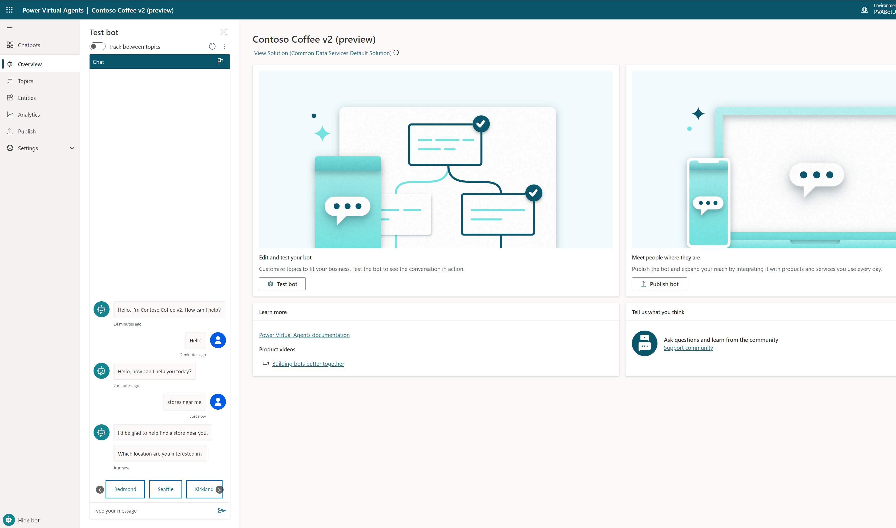
Creating your first bot
Take the time to familiarize yourself with the User Interface
Don’t try to do everything at once. Lab 01 keeps things simple with creating a topic, testing and publishing
Even if you finish the lab quickly, try repeating the same steps to become familiar with core actions

Slide 51
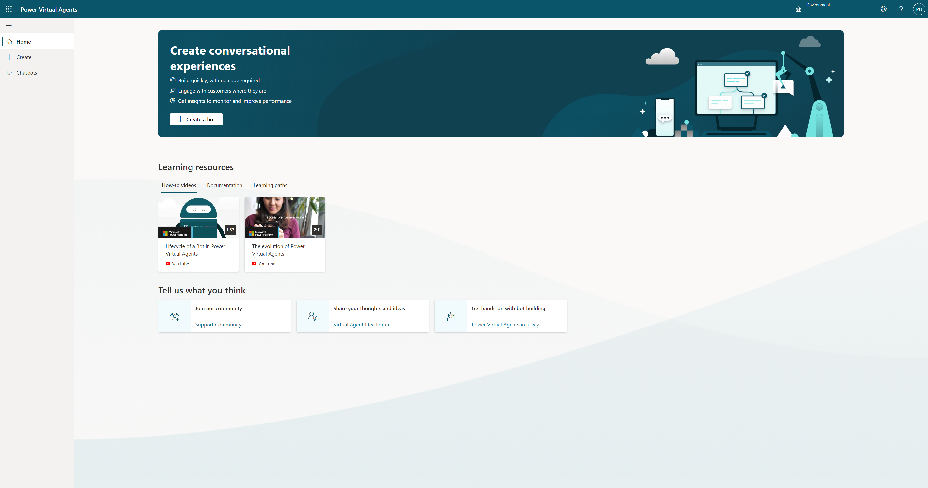
The ‘Home’ page

Slide 52
Click ‘Try the unified canvas (preview) for this lab when creating your new bot

Slide 53
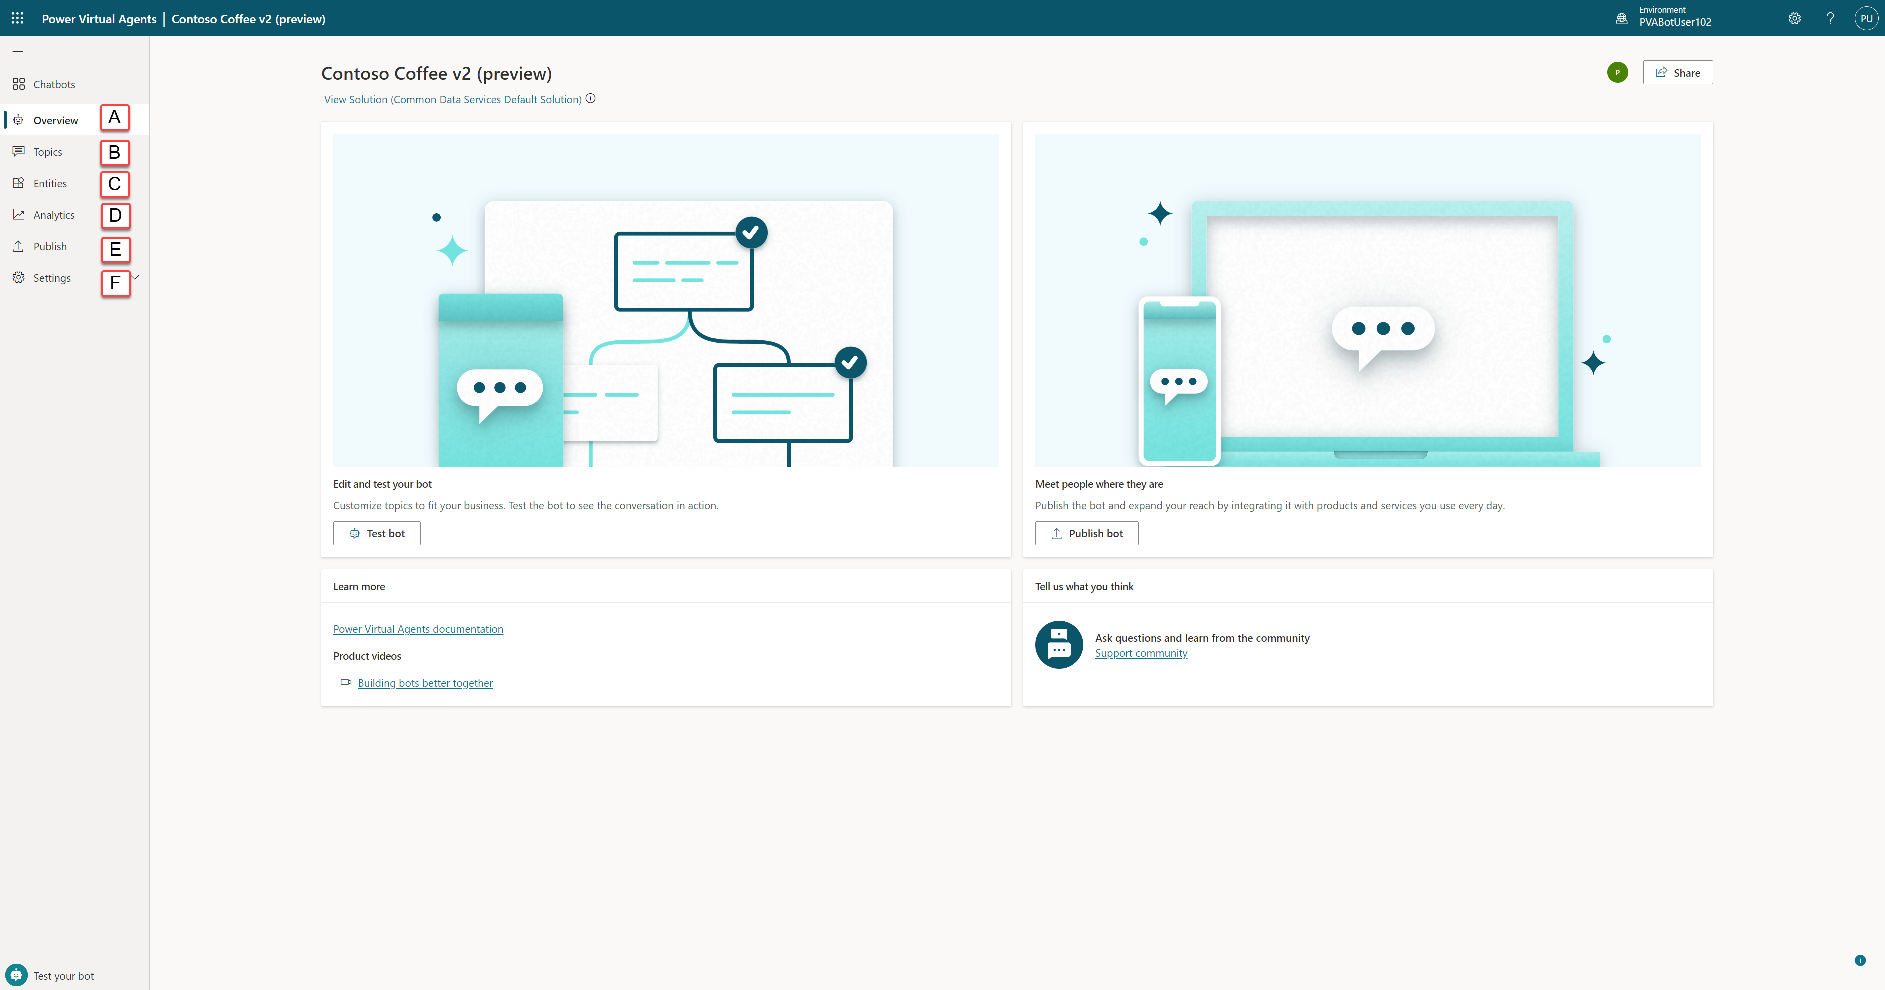
Notes:
Overview page, Displays your homepage including links to Test your bot, publish bot and links to documentation
Topics page, where you view, delete, create and edit conversation topics.
Entities page, where you view and create entities that Power Virtual Agents can recognize in customer conversations and load into variables.
Analytics page, where you view metrics to monitor how well your bot is serving your customers and find ways improve it.
Publish page, where you can publish the bot for team testing or to engage with your customers.
Settings page, where you can select General to change your chatbots name, image and get data like environment ID, Tenant ID and Bot app ID. Channels (such as your website or Facebook) you want customers to interact with your bot, Agent Transfer to configure connecting Power Virtual Agents to engagement hubs, configure Security to let your users sign into their account with you when using the bot, and extend your bot’s conversational capabilities AI Capabilities

Slide 54
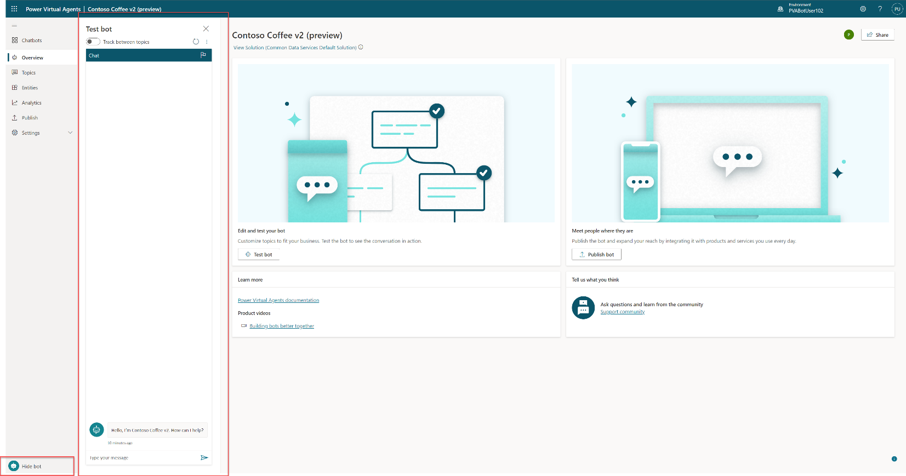

Slide 55
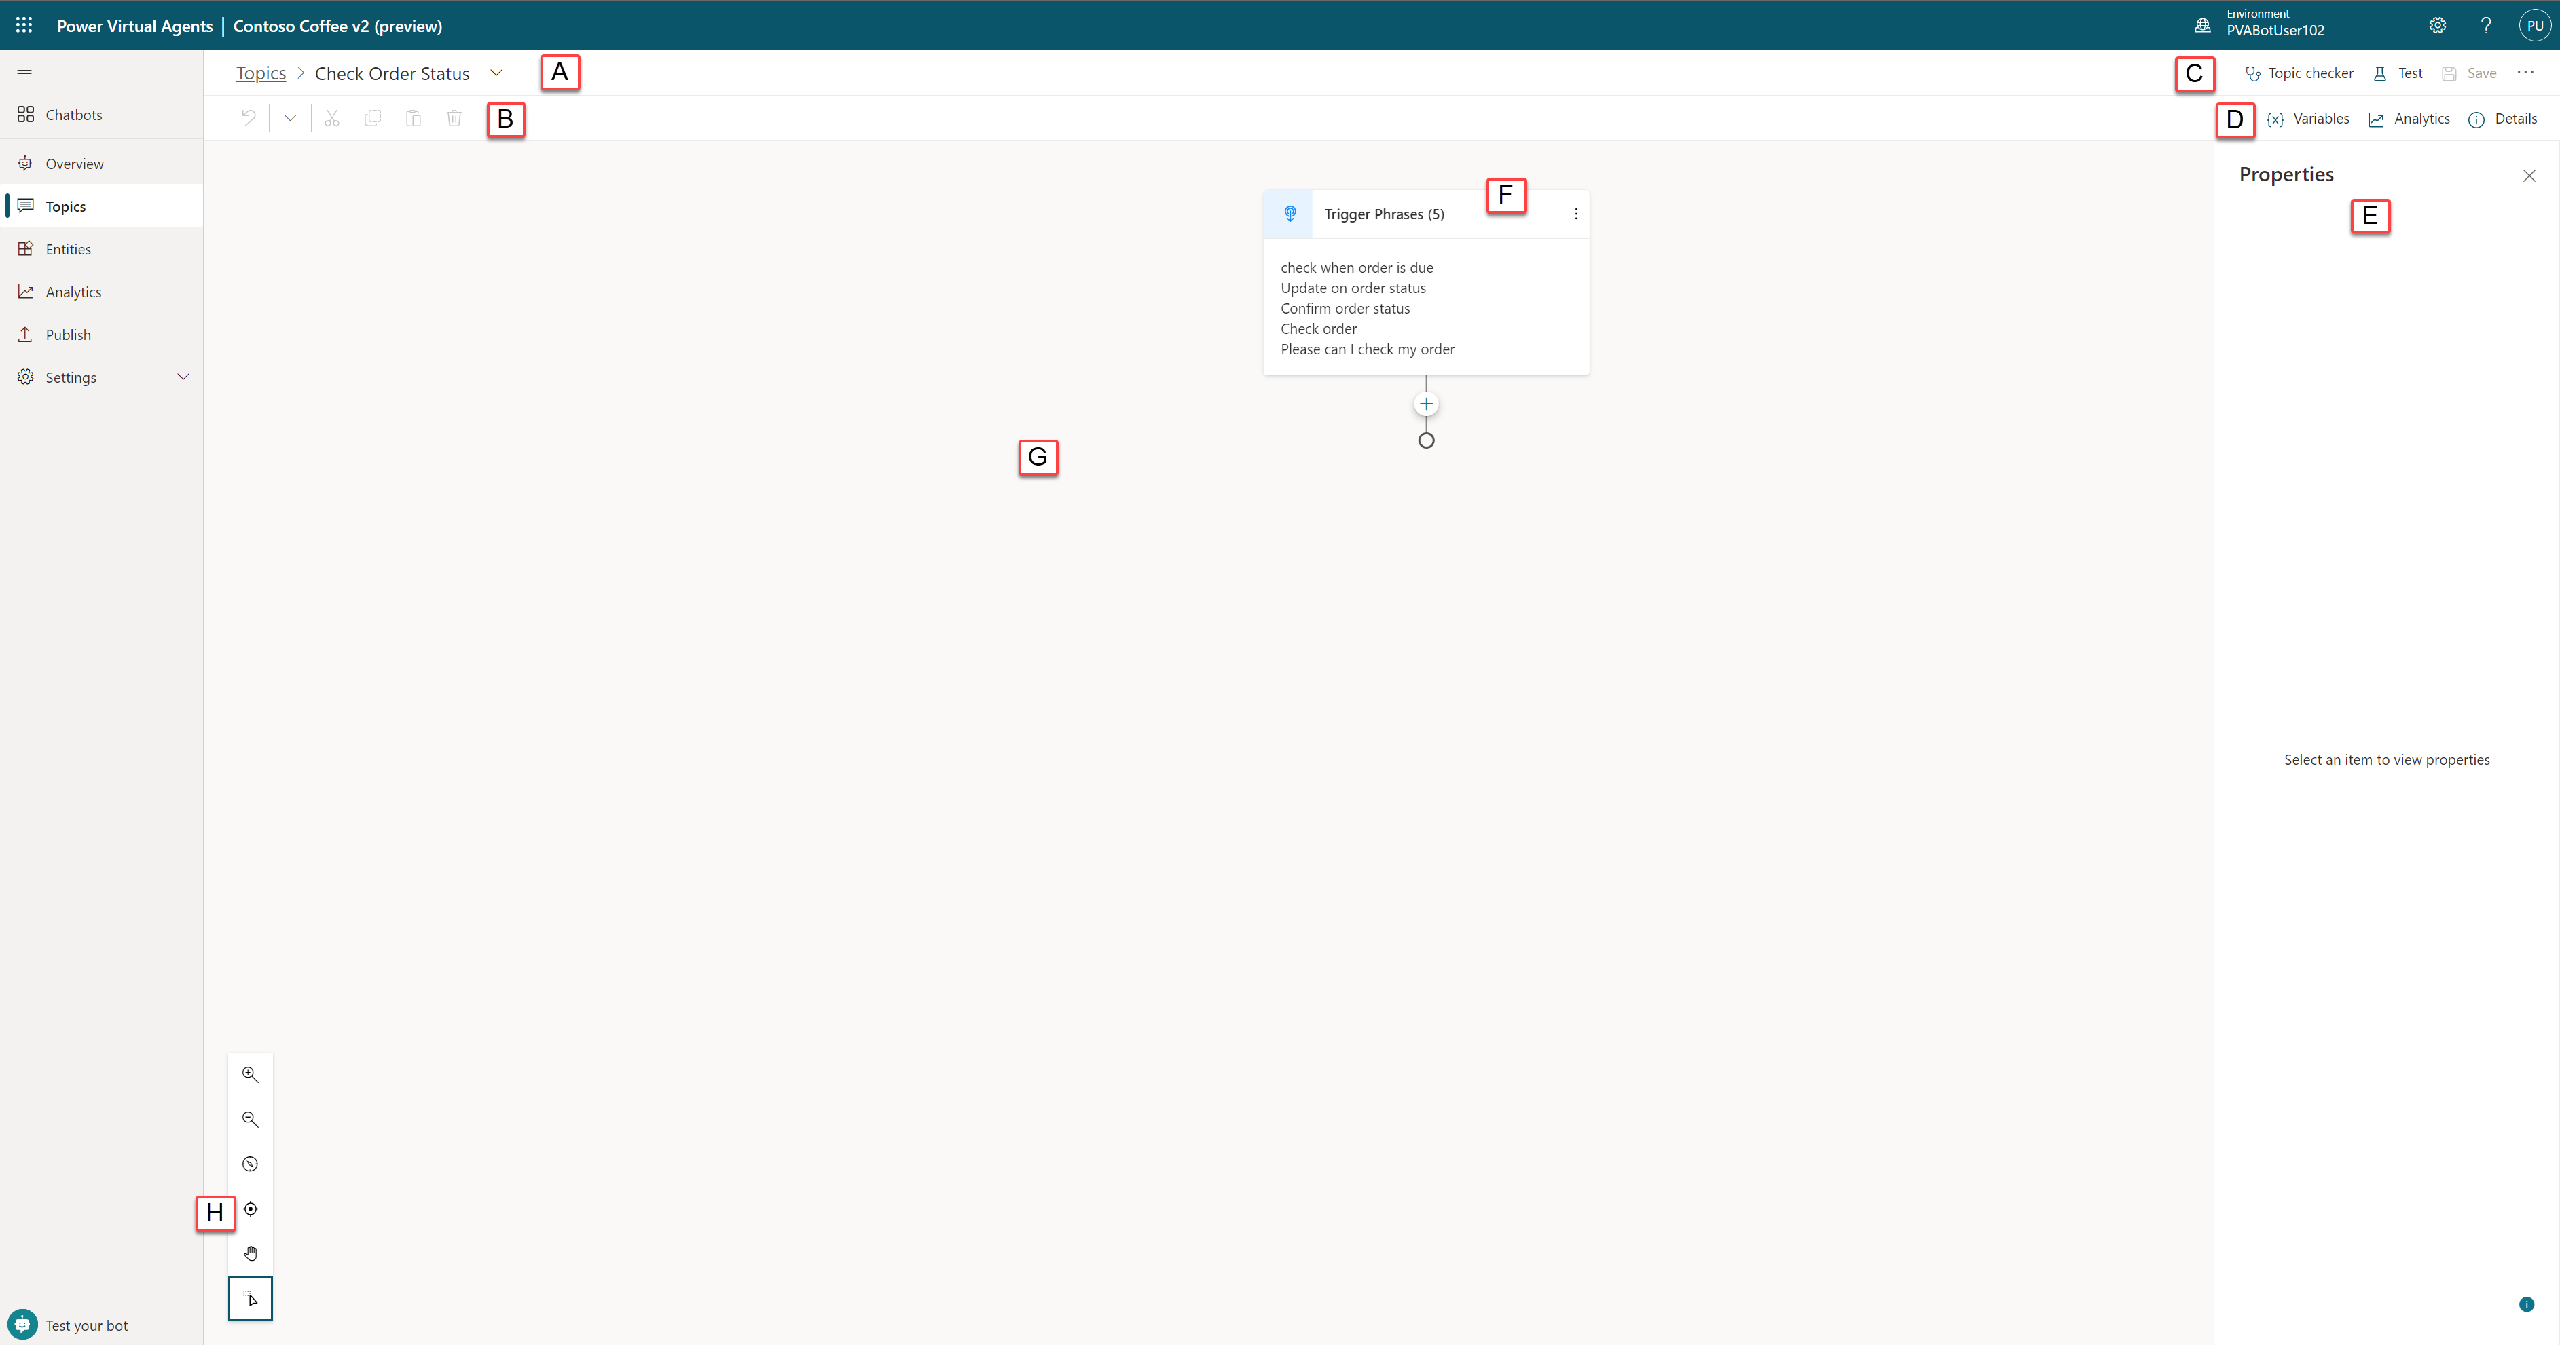
Notes:
Topic Title is the name of the topic you are currently authoring and is visible in the Topics page.
Productivity Bar is where you have access to productivity tools like copy and paste which is available in Preview
Topic Checker, Test and Save buttons include the Topic Checker which can be run anytime from the authoring canvas to check if there are any errors in your topic that the platform can detect , example include missing messages in message nodes. Test opens the bot testing panel on the left side of the screen, and the save icon which is available when there are unsaved changes, saves the topic. There is an extended menu ‘…’ button available here as well, which opens the code editor in Power Virtual Agents preview, allowing users to switch from the graphical view and the code view seamlessly
Variables, Analytics and Topic Details buttons provide three areas to access all the variables available in this topic and globally, analytics shows key metrics that are tracked within a time period including sessions and abandon rate, and the details menu allows you to change the name and description of the topic, and turn it on or off.
Properties are an extended menu item that allows for additional information or control depending on what is selected. Some items will not have any extended options and so this area can sometimes be empty, or for example selecting a question node’s properties, additional options become available in this section such as ‘Question Behaviour’
Nodes are what are referred to as the items within an authoring canvas in Power Virtual Agents and often have a type which drives what options are available and required. Examples include the message node, question node, or topic node.
The Authoring Canvas is where you would author your topic and is referred to a canvas due to the empty space that is gives you to build and connect nodes. It may look empty to begin with but as soon as you start adding nodes such as conditions, it will fill up fast!
Authoring Canvas Controls are what can be used to navigate the authoring canvas, which can become large for extensive topics. Controls included are zoom, grab and selection.

Slide 56
Best practices for writing topic trigger phrases

Slide 57

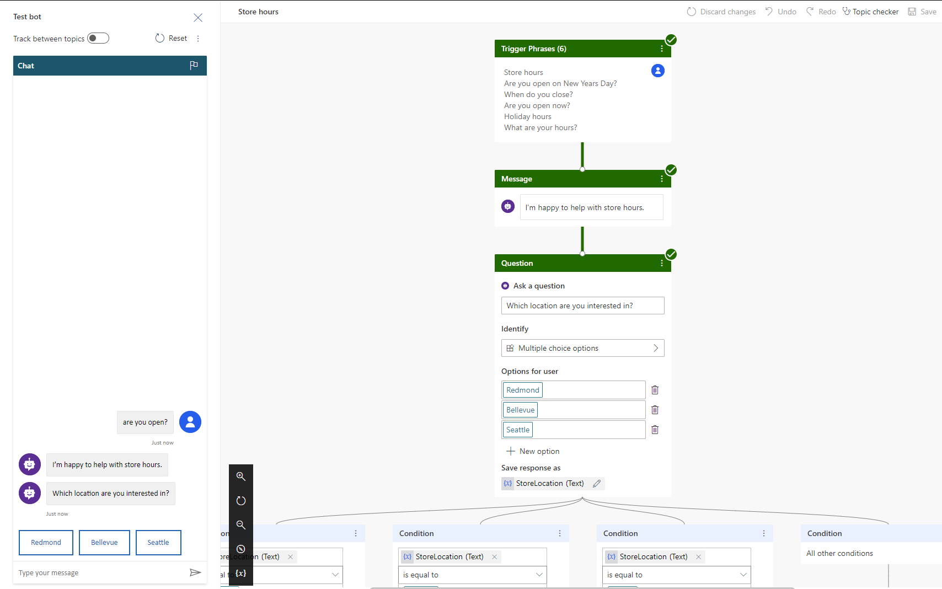
Trigger phrases – Definition
Trigger the chatbot to begin a conversation about a specific topic

Slide 58
Guidelines for better trigger phrase design
Clearly understand the goal and scope of the topic
Make sure the trigger phrases are semantically different
Start with 5 to 10 trigger phrases
Use the words your customers use!
Shorter trigger phrases with fewer than 10 words are generally better
Avoid trigger phrases that are highly ambiguous among different topics
Notes:
Here are some guidelines on writing better trigger phrases to ensure the right topics are triggering.
Trigger phrases should align with the goals and scope of the topic
Writing good trigger phrases using similar words that your end customer will use is very important in building successful chatbots
In order to have the right coverage, ensure you use trigger phrases that are semantically different
Start with 5-10 trigger phrases as you build topics and continue to add variations over a period of time.

Slide 59
Step 1: Pick a topic
Browse Products
Find Products
Special Products – Gift Cards
Refund
Shipment
Fees
Timeframe
“Return an Item”
Return/ Exchange
Pricing
Find a Promotion
Price Match
Member Benefits
Checkout
Delivery
Tax
Tax Calculation
Post-sale
Price Adjustment
Price Adjustment
Payment
Payment Methods
Address
Coupon
Shipment
Order Cancellation
Change/ Cancel Order
Address Validation
Shipping Address
Billing Address
Fraud Check
Order Confirmation
Back Order/Cancellation
Warranty
Order Status

Slide 60
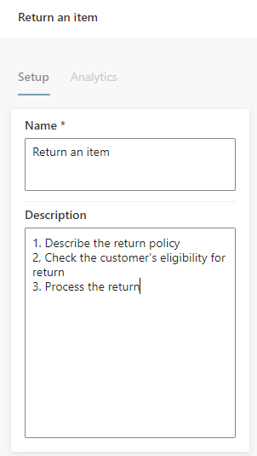
Step 2: Define the goal for the topic
Topic: "Return an item"
Goal:
1. Describe return policy of the store
2. Check customer’s eligibility for return
3. Process the return

Slide 61
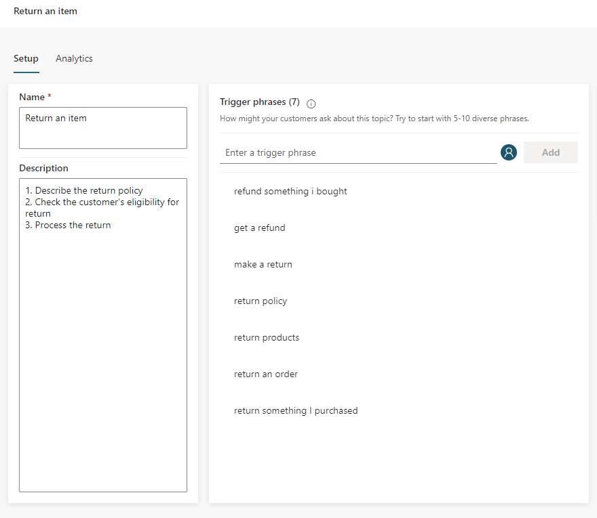
Step 3: Create trigger phrases
Steps:
Start with 5 to 10 trigger phrases. You may need more trigger phrases if the scope of the topic is large
Shorter trigger phrases with less than 10 words are generally better

Slide 62
Step 4: Review trigger phrases 1/3
Steps:
Make sure the trigger phrases are semantically different; using one different noun or verb could be enough to expand a topic’s coverage
Refund something I bought
Get a refund
Make a return
Return policy
Return products
Return an order
Return something I purchased

Slide 63
Step 4: Review trigger phrases 2/3
Adding articles (an, the, etc.), capitalization, contractions, and pluralization has a low chance of improving the triggering
Return some Products
Return Products
Return Product
Return a Product

Slide 64
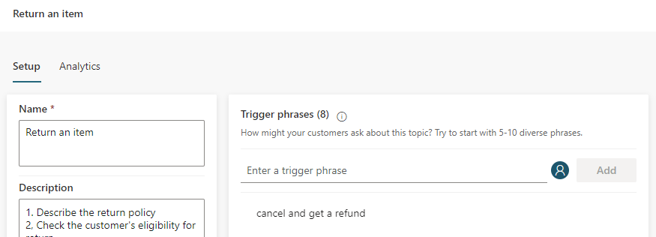
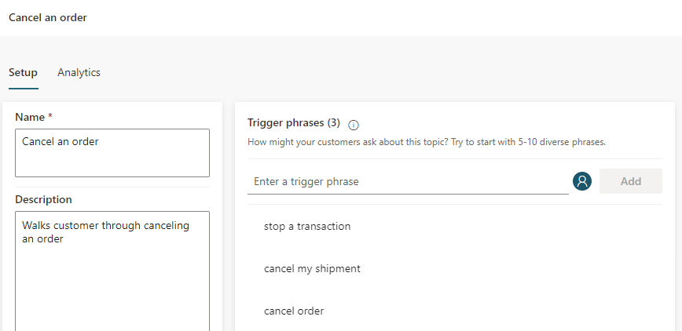
Step 4: Review trigger phrases 3/3
Avoid overlapping trigger phrases or ambiguous trigger phrases among different topics

Slide 65
Lab 02:
Creating your first bot

Slide 66
Authoring 101 in the Unified Authoring Canvas

Slide 67
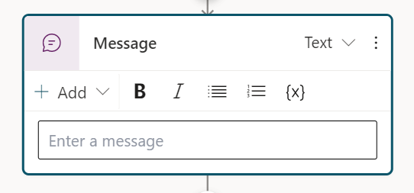
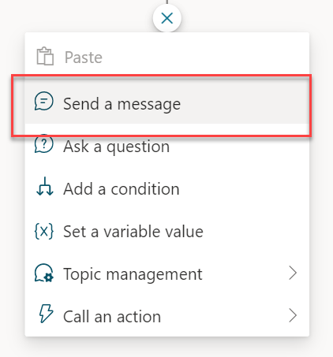
The Message Node
The Message Node is one of the most common nodes used when authoring bots
It allows you to display standard text, formatted text and dynamic data in the conversation

Slide 68
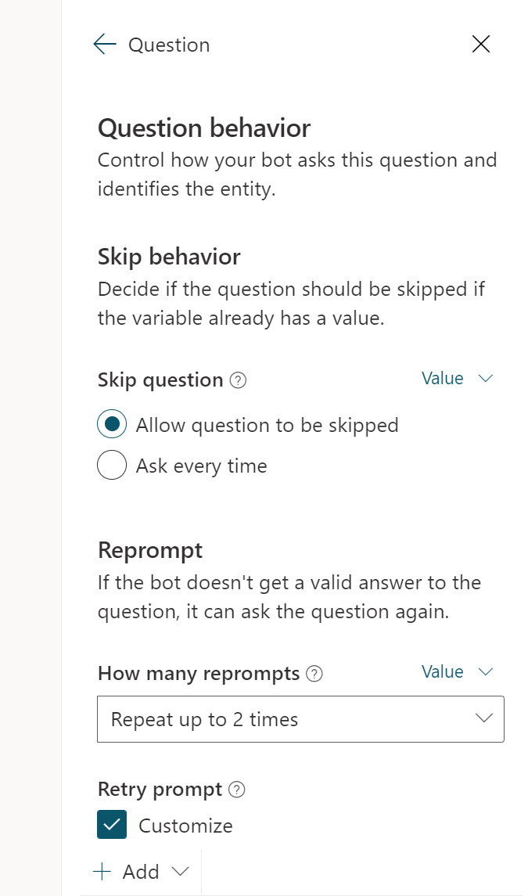
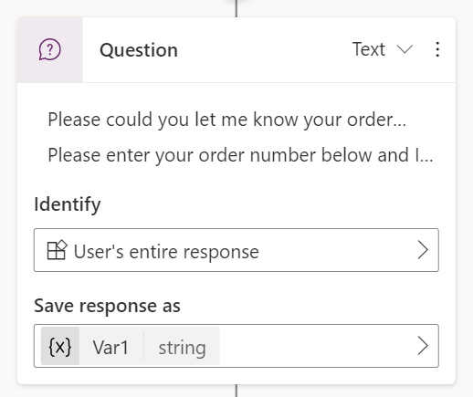
The Question Node
The Question Node is another of the most common nodes used when authoring bots
It provides capability to ask the user a question and store the data to be used and operated upon

Slide 69
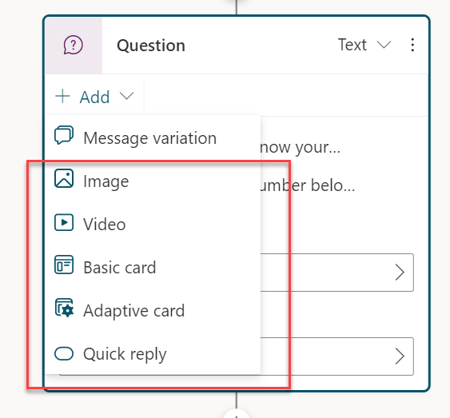
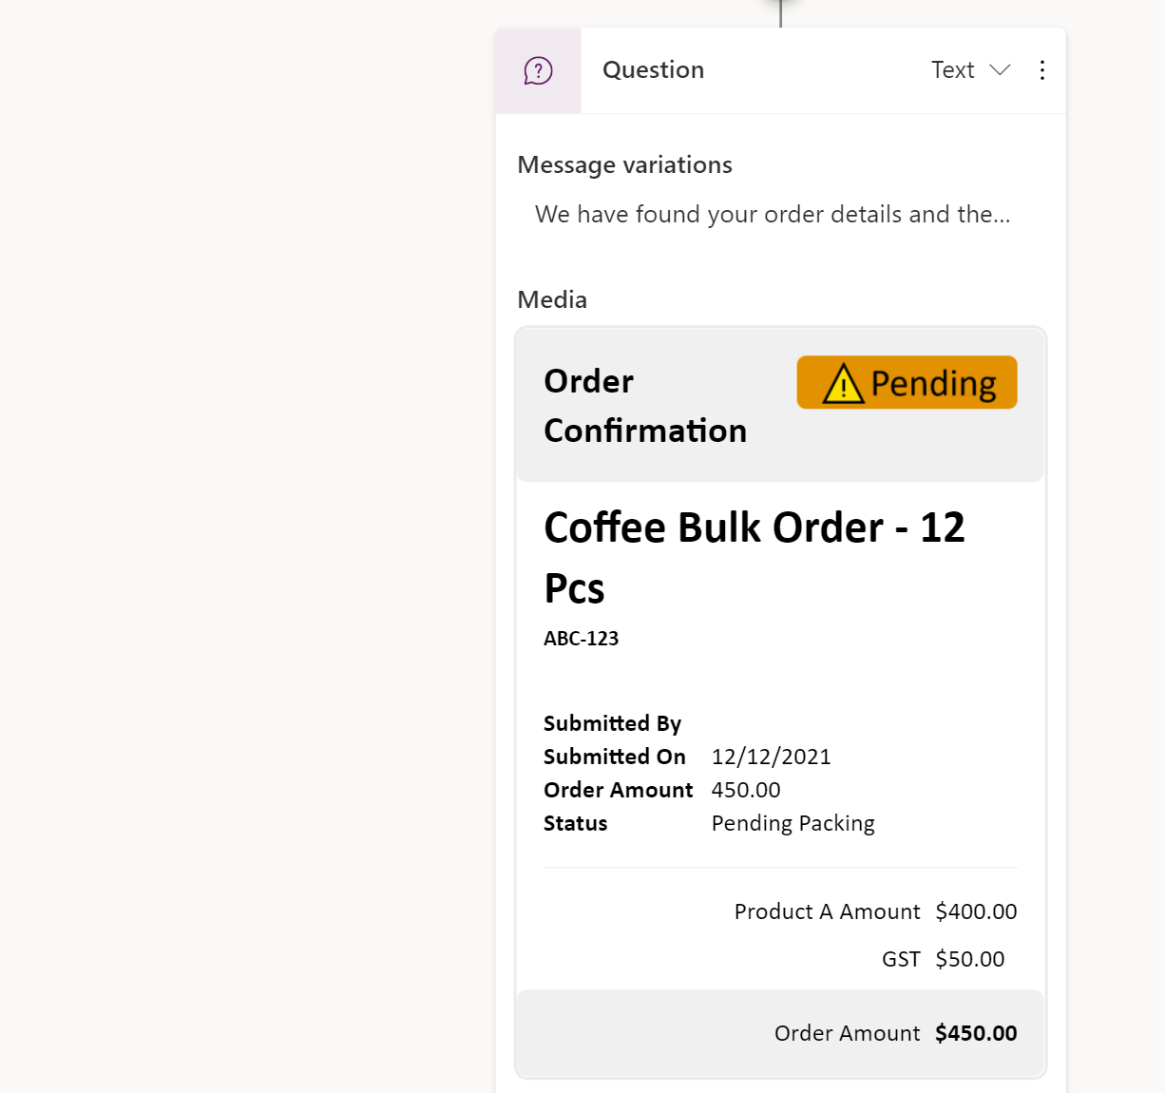
Rich Text Responses
Brand new rich text response options including image and adaptive card
Deliver enhanced experiences to customers and users which are more engaging and display data in more dynamic ways
Notes:
Image you can add an image which will be displayed on the card. Add the URL of the image and optionally a title.
Video you can add a video URL which needs to be a publicly available MP4 or a youtube video URL
Basic Cards are simple cards that provide adaptive card like visuals however require standard input such as Title, Messages and the ability to add ‘Buttons’ with basic actions.
Adaptive Cards can be added which are platform agnostic cards designed to be flexible to suit the need at the time, including requesting action, displaying information so it is displayed with emphasis on specific information or more. Power Virtual Agents preview supports Adaptive Cards v.1.3 at the time of writing and currently only informational cards are supported (you cannot use action.submit to return a value).
Quick Replies allow users to select from specific options rather than have to type the response out in text based scenarios. They are optional so a user can still type or speak their own response, and should be used to provide common suggestions or to help give the user ideas on the type of information being asked.

Slide 70
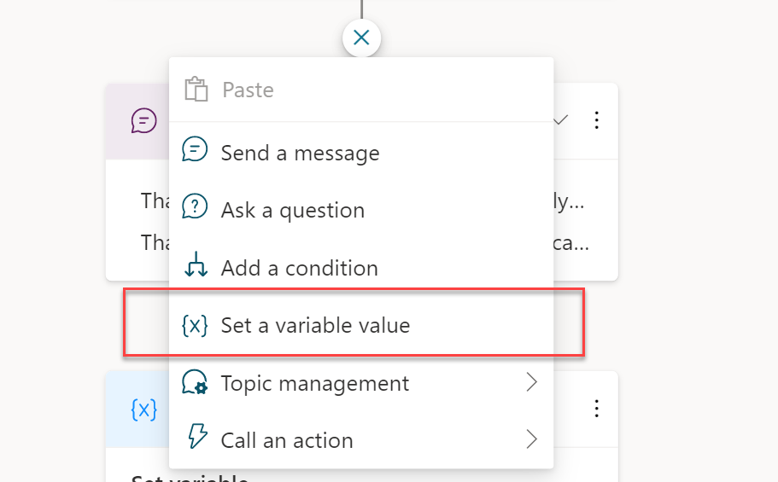
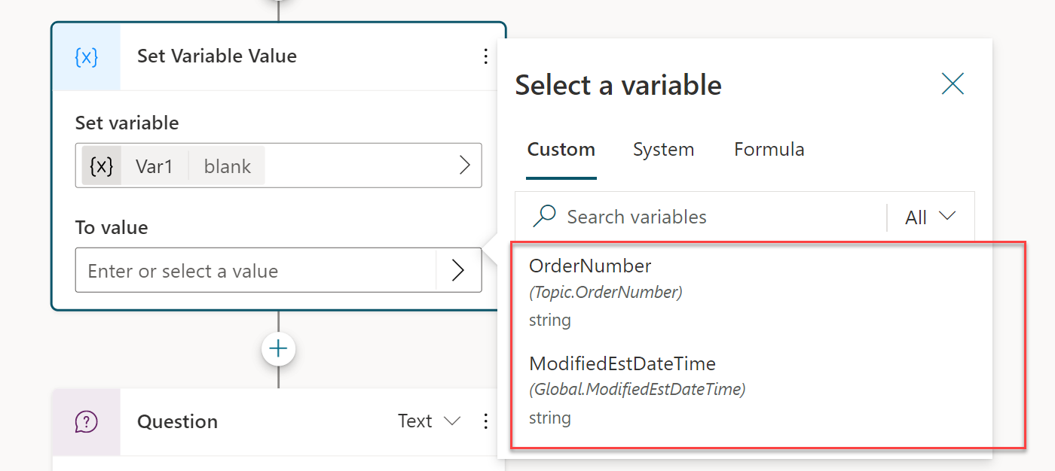
Use variables to navigate customers to tailored content
Direct your customers to content you want them to see
Add variables to keep customer information for later in the conversation
Notes:
Variables let you save responses from your customers in a conversation with your bot so that you can reuse them later in the conversation.
For example, you can save a customer's name in a variable called UserName. The bot can then address the customer by name as the conversation continues.
You can use variables to create logical expressions that dynamically route the customer down different conversation paths.
You can create a variable to use in a topic, or a bot (global) variable to use across topics.
You can also feed variables to Power Automate and Bot Framework Skills as input parameters, and save the output results from those actions.

Slide 71
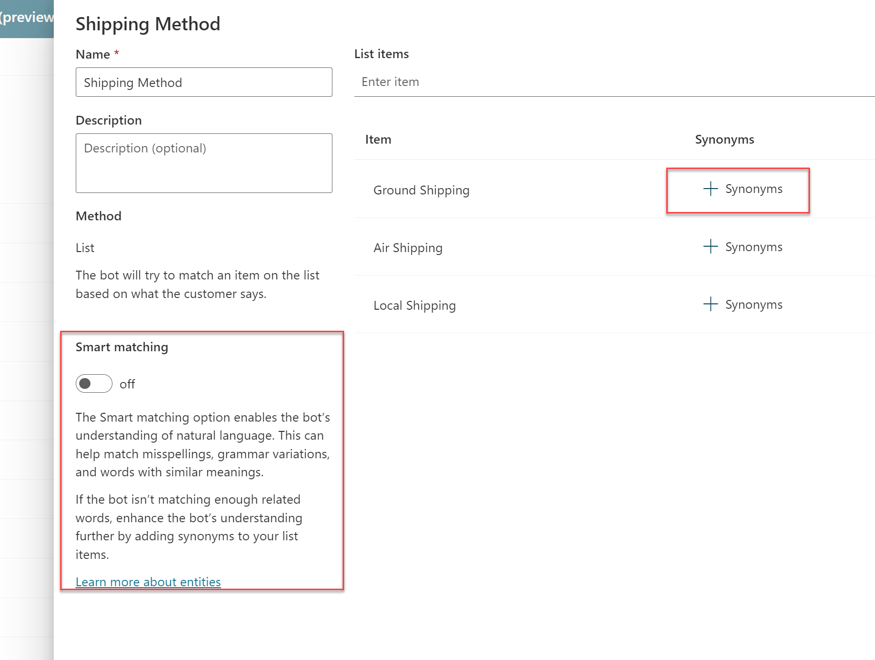
Entities and Slot-filling capabilities
Power Virtual Agents can intelligently avoid repetitive conversations
Enhances your efficiency as a maker
Power Virtual Agents can guide you to making the best experience
Notes:
The bot doesn’t follow the dialog script blindly. It intelligently uses all the information it has available to decide when to ask questions and when to skip them.
For example, if the user provided information earlier in the conversation the bot will remember that and skip asking about it again.

Slide 72
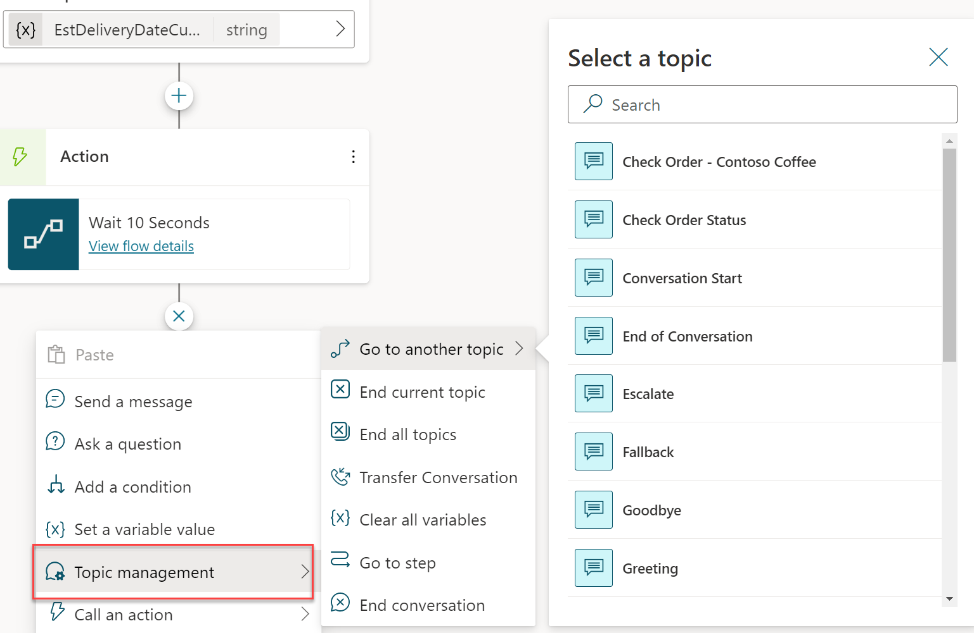
Topic Management
Re-direct and connect customers to related topics
Use it when:
A conversation requires more than one topic, such as when you need to ask a clarifying question to determine which topic the user needs
Notes:
Go to another topic: This node has an extended flyout menu where you can then go to another topic which needs to be selected
End current topic: This ends the current topic and it is used where the topic was called from another topic, from which it would be returned to where it was originally called from. This can also be used in branching conditions. If this is used to end an entire topic of branch, the behavior will operate like ‘End all topics’ below.
End all topics: End all active topics and the next message from the user will be as a new conversation, and the bot will trigger the most appropriate topic based on that user message, starting a new active topic.
Transfer Conversation is used to transfer to an agent and send a contextual message. (Not Supported in Preview)
Clear all variables clears all variable values. This is important if you want to begin or loop back into the same topic but take new values, especially if you have configured question behavior properties where a question could be skipped if it already had a value.
Go to Step allows a bot author to navigate to another node in the open topic. This is great for looping scenarios or if you want to gather more information from the user.
End Conversation confirms the customer has their query answered and would be a natural end to a conversation.

Slide 73
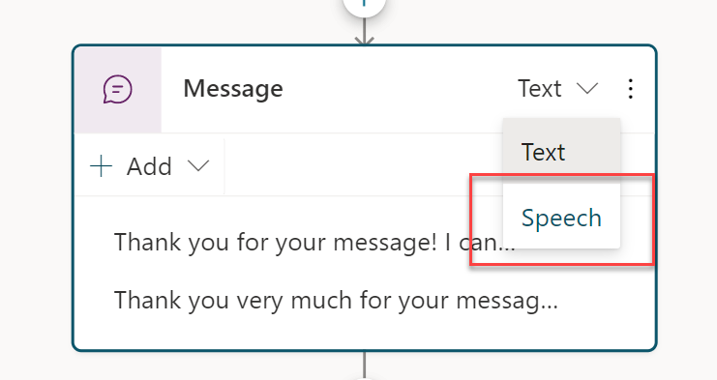
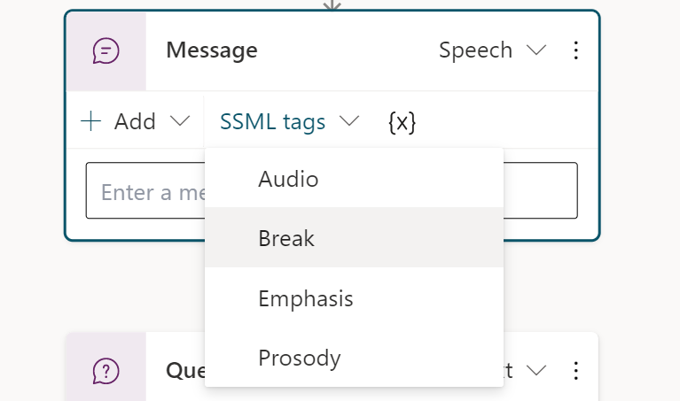
Use enhanced speech authoring capabilities
Directly add SSML overrides
Enhances speech enabled text bots
Tailor the best experience for your customers
Notes:
The bot doesn’t follow the dialog script blindly. It intelligently uses all the information it has available to decide when to ask questions and when to skip them.
For example, if the user provided information earlier in the conversation the bot will remember that and skip asking about it again.

Slide 74
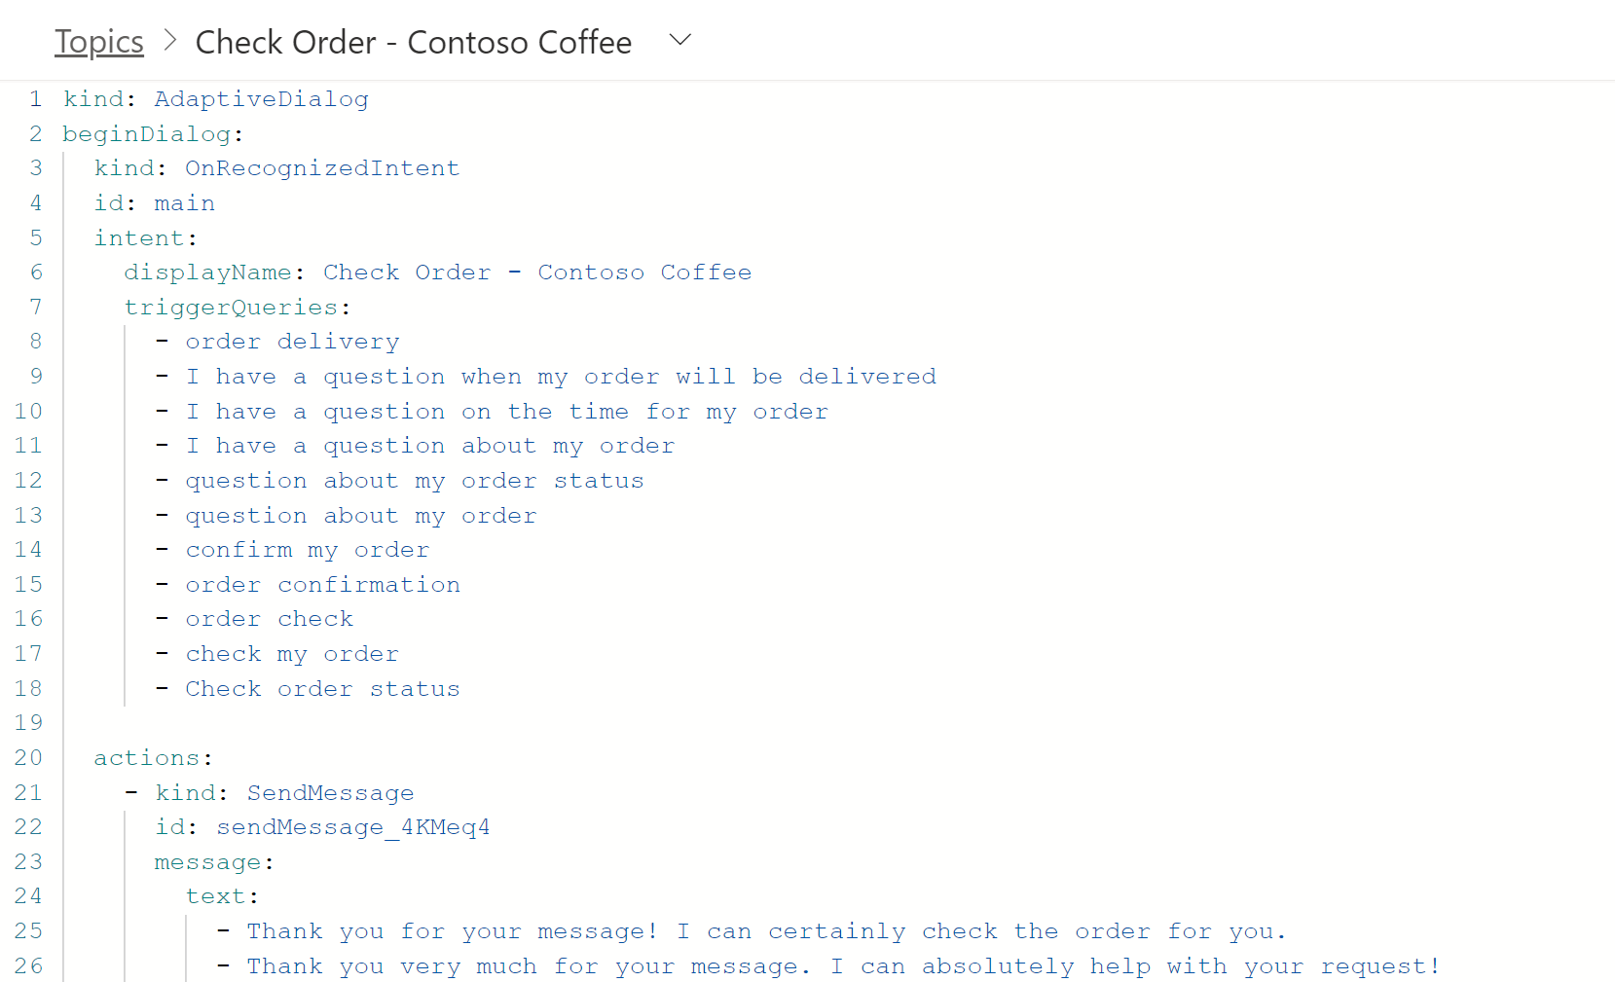
Productivity and Pro Code Options
Author bots faster with productivity options including copy and paste
Use the code view to quickly code message content
Modify anywhere dialog flow without disruption
Notes:
The bot doesn’t follow the dialog script blindly. It intelligently uses all the information it has available to decide when to ask questions and when to skip them.
For example, if the user provided information earlier in the conversation the bot will remember that and skip asking about it again.

Slide 75
Lab 03:
Authoring 101 in the Unified Canvas

Slide 76
Power Virtual Agents + Power Automate

Slide 77
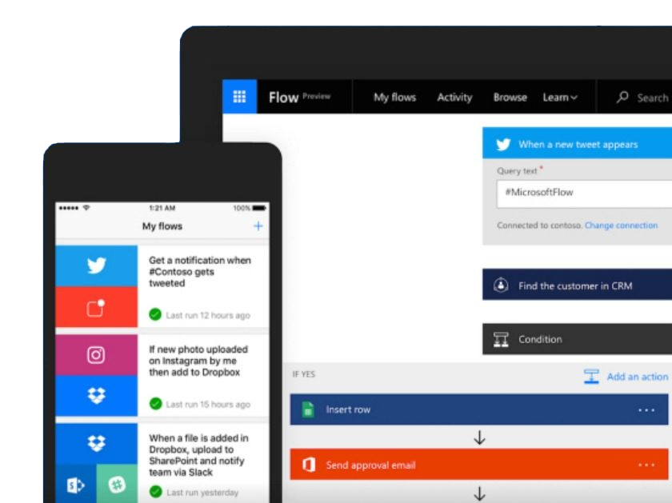
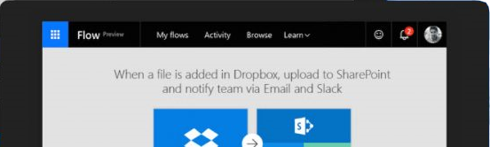
Microsoft Power Automate is an online workflow service that automates actions across
apps and services
Notes:
Power Automate is a SaaS services that helps you work smarter by automating workflow across you’re a growing number apps and services that business users rely on.
The possible workflows span across a wide variety of possibilities, for example :
Get a notifications when a certain file is updated
Synchronize files by connecting your folders to keep data current,
Automatically collect and organize your business data
Streamline approvals and get instant alerts.
Power Automate makes it possible to automate all of these scenarios and more.

Slide 78
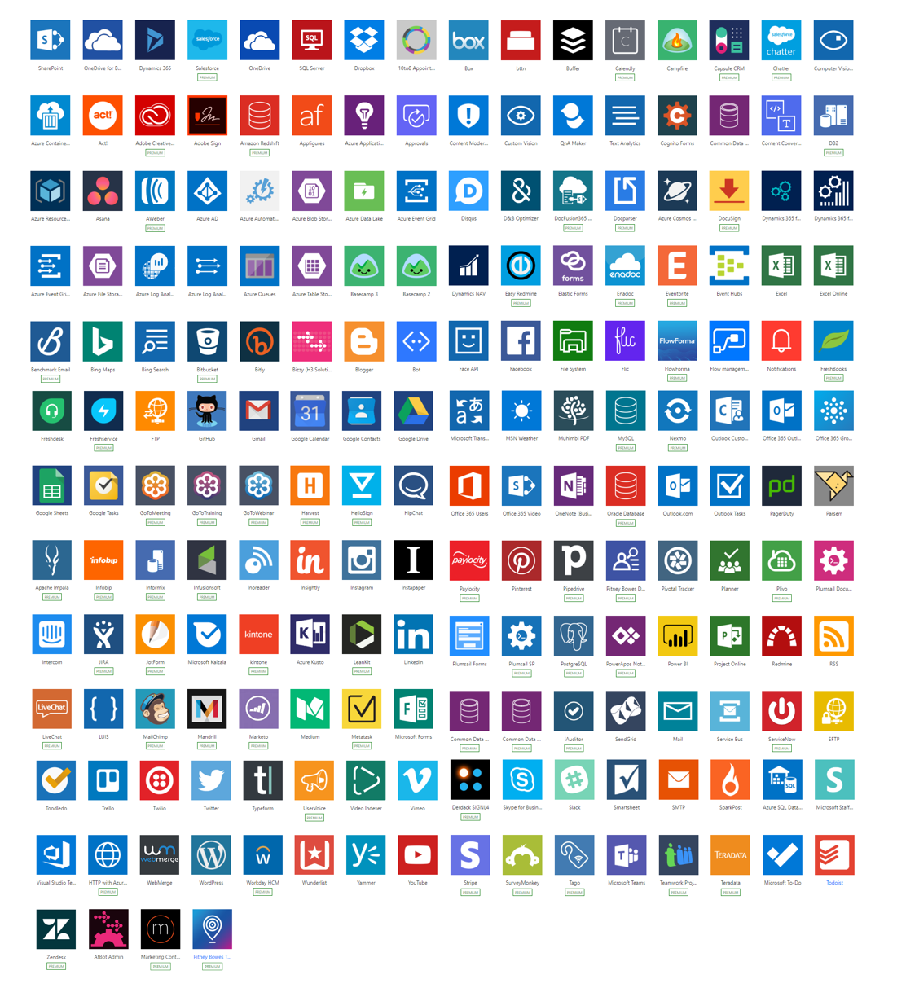
Connectivity & integration
Built-in connectivity to
450+ SaaS cloud services
File providers
Databases
Web APIs
Productivity apps, etc.
Connect to on-premises systems via Data Gateway
Pluggable extensibility via Custom Connectors to integrate existing LOB systems into Power Automate
Notes:
As part of the Power Virtual Agents license you get access to Power Automate. You will get access to over 450 premium connectors, which allow you to connect to third party services in a low-code graphical interface.
You can connect to any third-party service that Power Automate supports. You can read and write data from the database and you can pass data back and forth between the chatbot and Power Automate flow. You also have access to a very convenient HTTP connector in Power Automate which allows you to use your chatbot invoke any third-party API that you might have.
With the UI based flow connector in Power Virtual Agents, you can create flows in Power Automate just for your chatbot and invoke them seamlessly from Power Virtual Agents.

Slide 79
A service for automating workflows across apps and services
CONNECT
to data & systems you’re already using, and create the data you need
CREATE
workflows using triggers & actions without code or scripts
EDIT
flows on web and mobile
APPROVE
requests or manage them on web and mobile

Slide 80

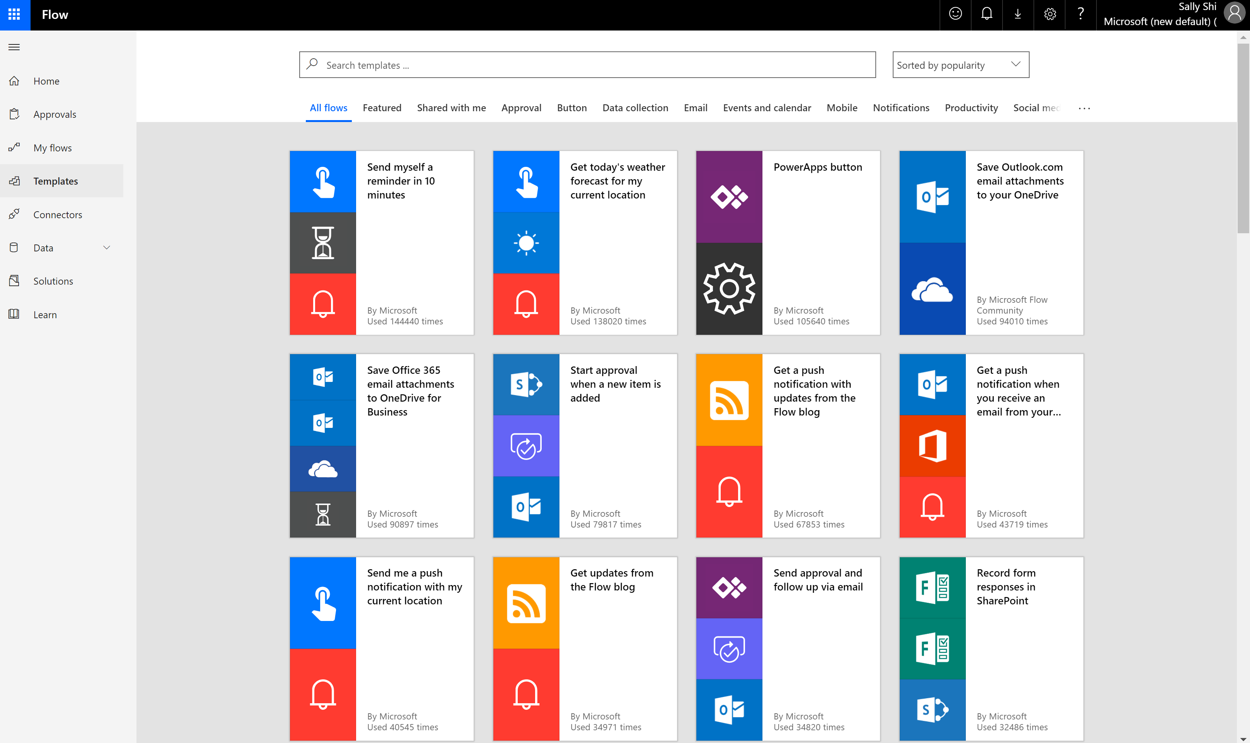
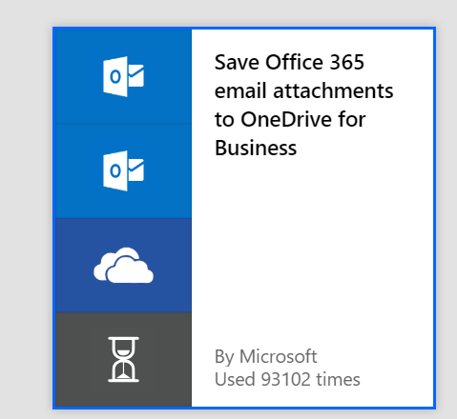
Get started with a growing library of templates
Jumpstart flows using over 100+ templates for common scenarios
Connect services you're already using in more meaningful ways
Notes:
Power Automate has a huge range of templates, which provide you a quick way to get started with commonly used flows and automations, and are also a great way to learn.

Slide 81





Efficient and secure data integration and storage
Power Automate is built on the Dataverse
Microsoft Dataverse lets you securely store and manage data that's used by business applications.
Dynamics 365
Office 365
Mobile Apps
Web Apps
Power BI
Power Apps
Power Automate
Power Virtual Agents
Microsoft Dataverse
Data connectors
Azure
Notes:
Power Automate is powered by Microsoft Dataverse. Dataverse lets you securely store and manage data that's used by business applications.

Slide 82
Unlock your imagination with Power Automate + PVA
Chatbot uses location-based services (LBS) to provide personalized services
2-factor authentications to increase security
Proactively recommends new promotions, benefits, and better rates to your customers
Check user eligibility and submit applications on their behalf
Remote diagnosis for IOT devices
Make appointments for your customers
Get a picture of the receipt from employee and use Azure AI for expense reimbursement (integration with Azure AI)
Notes:
Using Power Virtual Agents with Power Automate means your bot can do far more than just answer questions – it can take action on behalf of the customer. This can also include working with user authentication tokens, as we will see in the next section.
These are just some of the examples of the huge range of scenarios and use cases that can be enabled by Power Virtual Agents and Power Automate.

Slide 83
Lab 05:
Build a Power Automate flow

Slide 84
Closing: Wrap up and next steps

Slide 85

Learn more about Microsoft Power Virtual Agents
Visit Power Virtual Agents to learn more and request a demo
Technical details about the application are available in our help documentation
Check Power Virtual Agents Blog to learn more best practices and updates
View upcoming and planned features on the Roadmap
Explore Customer Stories
For questions please engage in our Community forum
Learn about the Power Platform

Slide 86
DISCLAIMER
MICROSOFT POWER VIRTUAL AGENTS (1) IS NOT INTENDED OR MADE AVAILABLE AS A MEDICAL DEVICE FOR THE DIAGNOSIS OF DISEASE OR OTHER CONDITIONS, OR IN THE CURE, MITIGATION, TREATMENT OR PREVENTION OF DISEASE, OR OTHERWISE TO BE USED AS A COMPONENT OF ANY CLINICAL OFFERING OR PRODUCT, AND NO LICENSE OR RIGHT IS GRANTED TO USE MICROSOFT POWER VIRTUAL AGENTS FOR SUCH PURPOSES, (2) IS NOT DESIGNED OR INTENDED TO BE A SUBSTITUTE FOR PROFESSIONAL MEDICAL ADVICE, DIAGNOSIS, TREATMENT, OR JUDGMENT AND SHOULD NOT BE USED AS A SUBSTITUTE FOR, OR TO REPLACE, PROFESSIONAL MEDICAL ADVICE, DIAGNOSIS, TREATMENT, OR JUDGMENT, AND (3) SHOULD NOT BE USED FOR EMERGENCIES AND DOES NOT SUPPORT EMERGENCY CALLS. ANY CHATBOT YOU CREATE USING MICROSOFT POWER VIRTUAL AGENTS IS YOUR OWN PRODUCT OR SERVICE, SEPARATEAND APART FROM MICROSOFT POWER VIRTUAL AGENTS. YOU ARE SOLELY RESPONSIBLE FOR THE DESIGN, DEVELOPMENT, AND IMPLEMENTATION OF YOUR CHATBOT (INCLUDING INCORPORATION OF IT INTO ANY PRODUCT OR SERVICE INTENDED FOR MEDICAL OR CLINICAL USE) AND FOR EXPLICITLY PROVIDING END USERS WITH APPROPRIATE WARNINGS AND DISCLAIMERS PERTAINING TO USE OF YOUR CHATBOT. YOU ARE SOLELY RESPONSIBLE FOR ANY PERSONAL INJURY OR DEATH THAT MAY OCCUR AS A RESULT OF YOUR CHATBOT OR YOUR USE OF MICROSOFT POWER VIRTUAL AGENTS IN CONNECTION WITH YOUR CHATBOT, INCLUDING (WITHOUT LIMITATION) ANY SUCH INJURIES TO END USERS.

Slide 87
THANK YOU

